Slide 1
Easy readers’ advisory with Library Aware
Brought to you by Pioneer Library System! Presented by Lindsay Stratton, 4/15/16

Slide 2
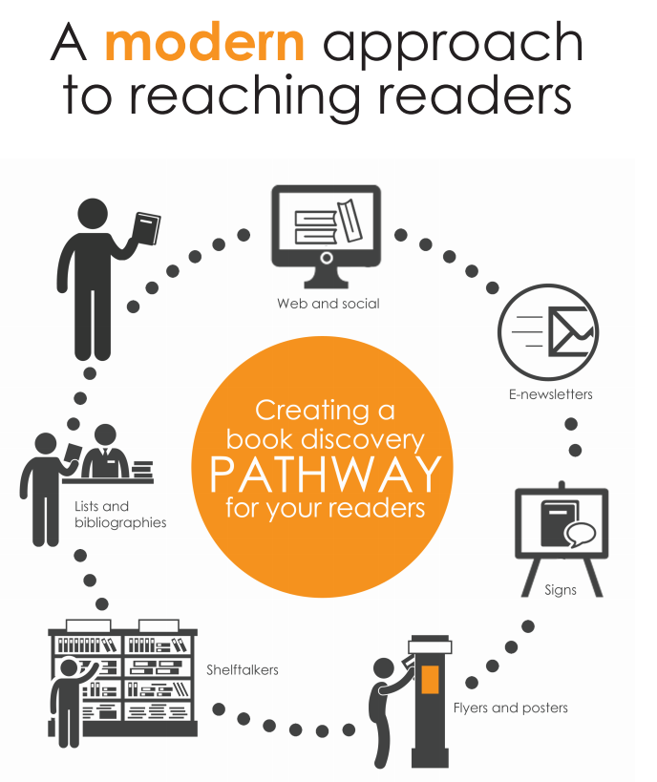
What is it?
Tools to easily create attractive Reader’s Advisory materials – powered by Novelist

Slide 3
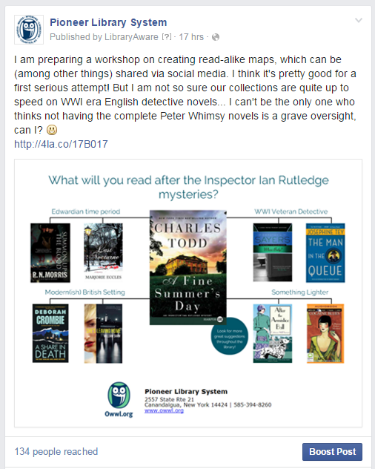
Social
Post promotions, fliers, etc. to Facebook, Twitter, and Pinterest

Slide 4
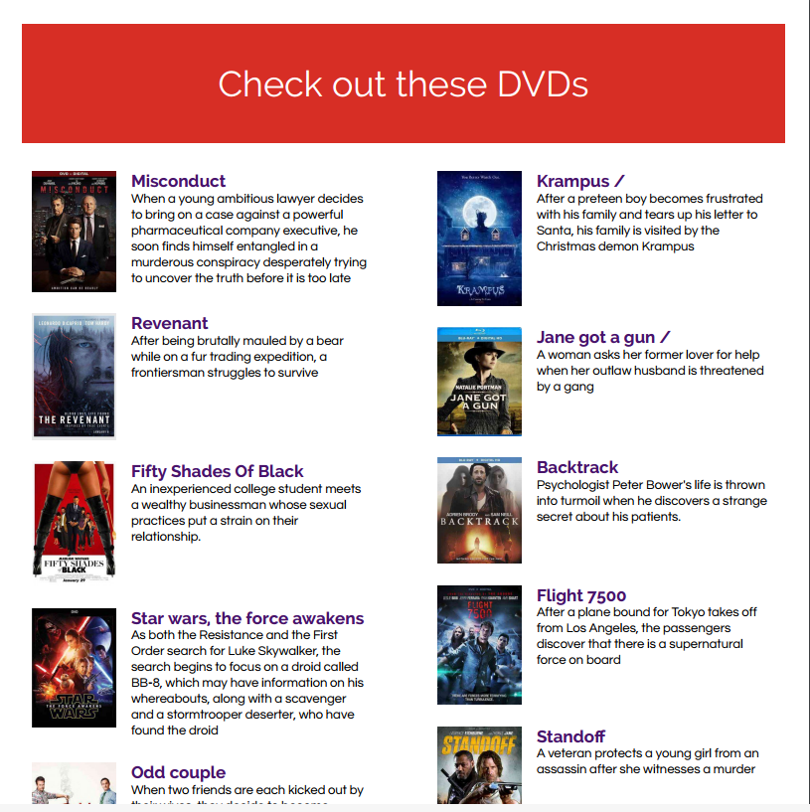
Lists
Create book (or DVD!) lists with cover images, summaries, and more!

Slide 5
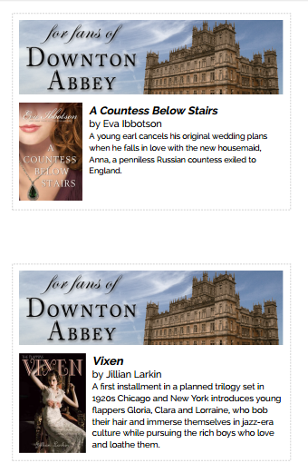
Shelf talkers
Put reviews, descriptions, and recommendations right on the shelves!

Slide 6
Fliers, posters, signs
Advertise programs, events, or library news; create engaging library navigation

Slide 7
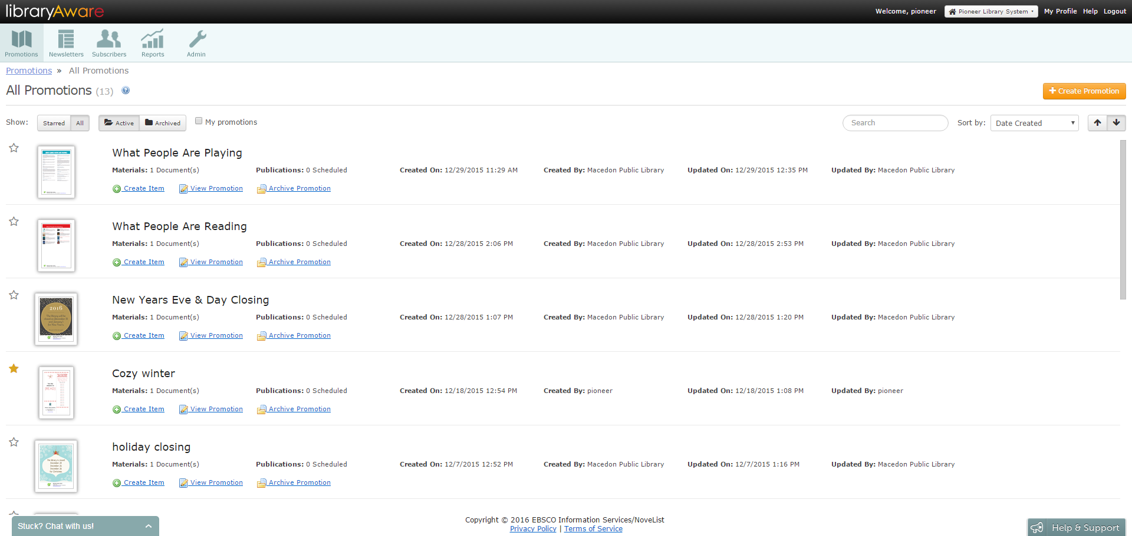
https://www.libraryaware.com/login

Slide 8
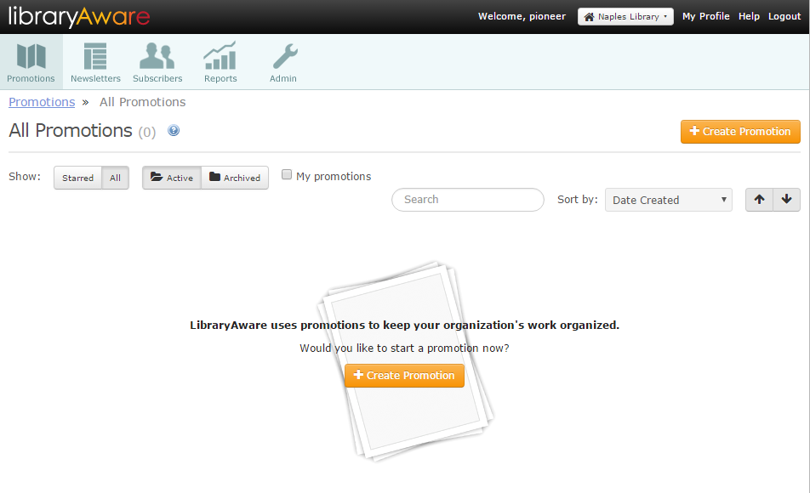
Get started
Create a new promotion

Slide 9
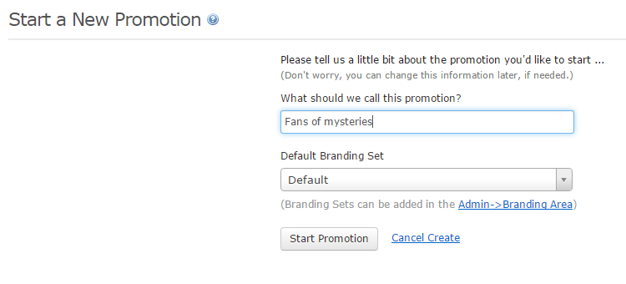
Start a new promotion
Promotion name
Multiple items can go into a single promotion
Branding set
Library info & logo
Notes:
The promotion can be a one one-off thing, or a series. For example, you might have a recurring feature - Top 10 books of the month. Each month’s books will be different, but the general design will be the same. So you would name your promotion “Top 10 books” (or DVDs or whatever) instead of “Top 10 books of April”. In this example, I want to do a series highlighting weird facts about various books.
Each library will typically have one branding set, which includes the library’s name, address, URL, and logo. However, if you have a separate logo for your teen services, or children’s services, you can create and use branding sets specific for those.

Slide 10
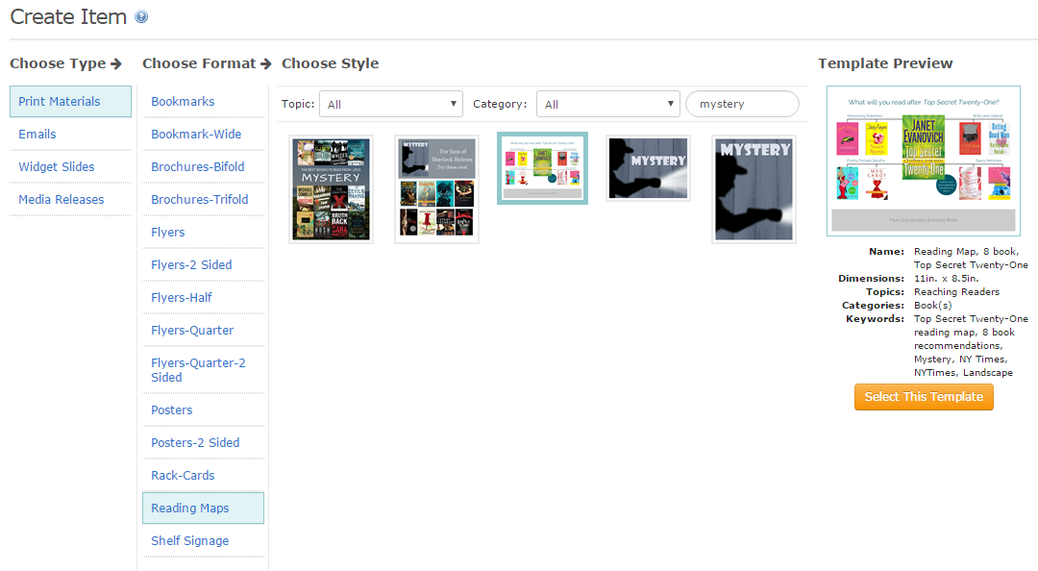
Select a template
Type
Format
Style
Notes:
There are four types of promotion - print (which also includes materials you can post to Facebook), emails, widgets, and media releases). I’m focussing on print materials.
Format options change depending of the type. There are a lot of options, and each option has it’s own templates. I’m selecting shelf signage, a

Slide 11
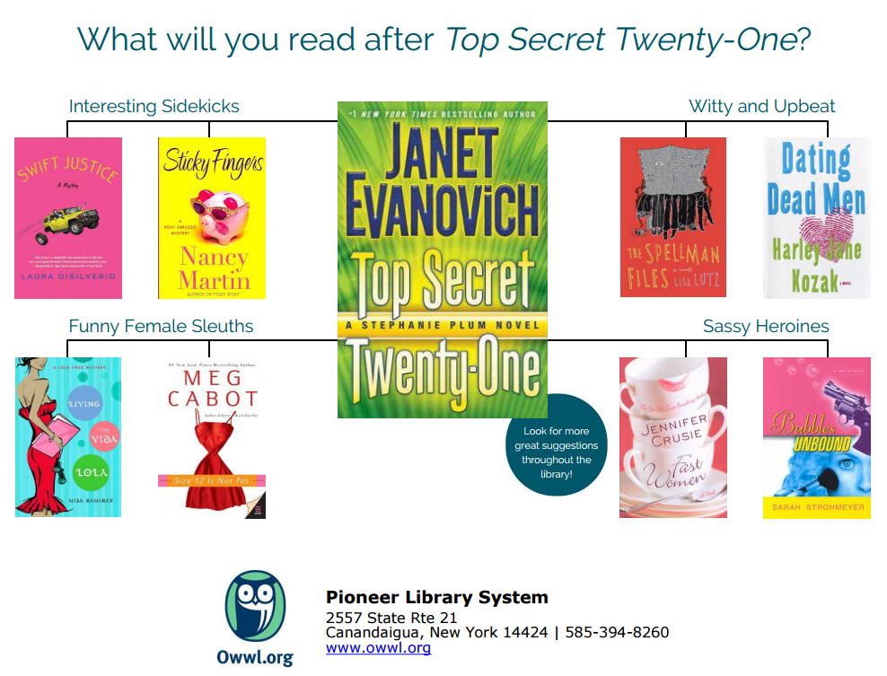
Select and go
Premade promotions that you can use as is*
(*but you want to make sure our libraries own the items listed!)

Slide 12
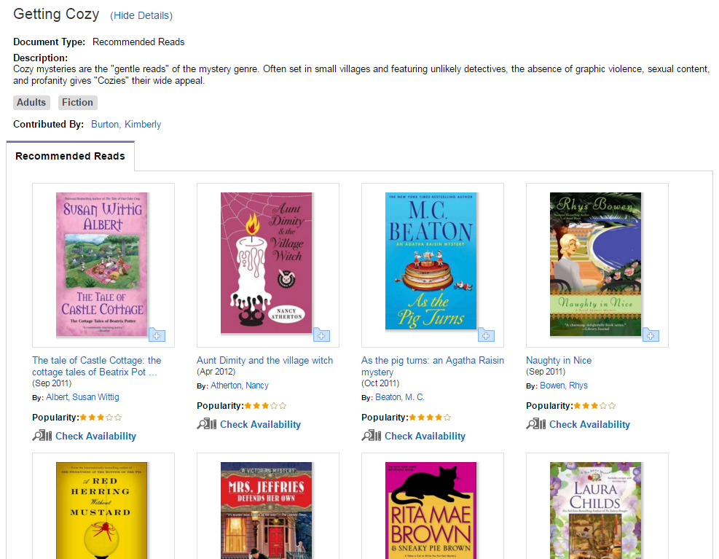
Or customize
Use Novelist to select titles
Novelist > Keeping Up > Mystery > Getting Cozy list

Slide 13
This is just the tip of the iceberg…
Online tutorials and help - https://libraryaware.uservoice.com/knowledgebase/
Request on-site training – call or email Lindsay

