Slide 1
OUR COMMUNITY READS
How it all began….

Slide 2
How it all began….
Books from Birth
Reading in Lyons
Safe Schools Healthy Students

Slide 3
OBJECTIVES
Leave with a clear understanding of the Our Community Reads model
Appreciate the value and effectiveness of services already being offered
Understand the importance of engagement & outreach

Slide 4
Components of OCR
In School
Volunteer Readers in Classrooms
Book Give-Aways at school
With Family
Family Fun Literacy Nights
Literacy & Numeracy Activities & Stories
With Community
Our Community Reads Events
Thematic learning centers
Occurs Weekly
Healthy Snack
Book Give-Aways
Occurs Monthly
Healthy Snack
Book Give-Aways
Occurs monthly or bi-monthly
Bookmarks sent home that have Family Fun Literacy dates & times

Slide 5
Pouring Gas on a Fire
…..Rationale, Resources & Program Structure

Slide 6
Program Success
Creative Partnerships
Strong Rationale & Clear Objectives
Well articulated model
Flexible funding streams

Slide 7
Program Success
Creative Partnerships
Strong Rationale & Clear Objectives
Well articulated model
Flexible funding streams

Slide 8
Early Childhood Think Tank (2012)
SSHS grant– Family Educator
25-35 people
Represent a cross section of partners
Discussed essential questions
Brainstormed program ideas

Slide 9
Partners
Lake Ontario ABCD
Literacy Volunteers
Head Start
Parent Teacher Associations
Sodus Central School District
Sodus Community Library
SSHS
WayneCAP
Wayne County Dept. of Aging & Youth
21st Century Community Learning Centers

Slide 10
Wayne County Partnership for Strengthening Families (Fall 2013)
25+ organizations & schools
Academic Achievement Work Group
K-Ready
Attend
College & Career Ready
Organize a K-Ready Forum
8 School Districts & a host of partners
Determine to do a survey….

Slide 11
2013 into 2014 …Very Messy….
SSHS is still going…
21st CCLC is starting up
Priority UPK grants are beginning
WCPSF is picking up steam
Derek is driving all over the place reading to children
BUT THERE WAS A COMMON FOCUS:
Are the children ready for Kindergarten?

Slide 12
Program Success
Creative Partnerships
Strong Rationale & Clear Objectives
Well articulated model
Flexible funding streams

Slide 13
Kindergarten Questionnaire
Pre-K Surveys | Total | Sample | % of
10 Schools | Enrolled | Number | Total
Total | 1,004 | 585 | 58.3%
What is your relationship to the child being enrolled today? | Number | Percent
Mother or step-mother | 501 | 87.1%
Father or step father | 55 | 9.6%
Grandparent | 11 | 1.9%
Other relative | 1 | 0.2%
Legal guardian | 7 | 1.2%

Slide 14
Parent Education Level
What is the highest level of education reached by anyone in the child’s household: | Number | Percent
Some school, | 13 | 2.3%
GED/HS Diploma, | 123 | 21.5%
Some college | 131 | 22.9%
Completed 2 Year college | 109 | 19.1%
Completed 4 Year college or more | 196 | 34.3%

Slide 15
Moved in Past 5 Years
Parents' College Experience | No College | Some College
How many times has this child moved in the last five years? | Percent | Percent
He/she have not moved | 30.3% | 50.8%
He/she moved once | 31.0% | 28.3%
He/she moved twice | 16.2% | 11.3%
He/she moved three times | 15.5% | 5.5%
He/she moved four or more times | 7.0% | 4.1%

Slide 16
Family Activity
Parents' College Experience | No College | Some College
In a typical week, how many hours does this child spend with his/her family in activities such as going to the library, participating in scouts, sports, organized recreation, counseling, volunteer fire department, siblings’ school events, church, family field trips or other activities. | Percent | Percent
He/she doesn’t spend any time doing activities with the family. | 1.4% | 0.7%
He/she spends between one(1) or two(2) hours doing activities with the family | 23.9% | 8.0%
He/she spends between three(3) or four(4) hours doing activities with the family | 26.8% | 26.9%
He/she spends five(5) or more hours doing activities with the family | 47.9% | 64.4%

Slide 17
Reading Material in Home
Parents' College Experience | No College | Some College
How many books, magazines (print material) are in this child’s home? | Percent | Percent
There are few or none | 4.2% | 0.5%
There are books, magazines or other printed material in one or two places in the child’s home | 26.8% | 8.9%
There are printed materials in some rooms | 16.2% | 11.0%
In almost every room | 52.8% | 79.6%

Slide 18
Parent/Adult Reads to Child
Parents' College Experience | No College | Some College
How often do you or another adult read with this child? | Percent | Percent
He/she never reads with me or another adult | 3.5% | 0.7%
He/she read with me or another adult 3 or less times a week | 45.1% | 17.6%
He/she reads with me or another adult 4-6 times a week | 38.0% | 48.6%
He/she reads with me or other adults 7 or more times a week | 13.4% | 33.1%

Slide 19
Parent Reading Habits
Parents' College Experience | No College | Some College
Which best describes your reading habits( not this child’s habits): | Percent | Percent
I rarely read | 21.3% | 6.7%
I read for work | 13.2% | 15.9%
I read for pleasure | 52.2% | 74.9%
I have some difficulty reading | 13.2% | 2.5%

Slide 20
So we need a program….
That can be recognized across communities
That is approachable for a broad range of audiences
That builds foundational experiences for family literacy-
enhancing background knowledge
increasing vocabulary
equipping parents with skills that can transfer to the home
Particularly comfortable for people without college experience

Slide 21
Program Success
Creative Partnerships
Strong Rationale & Clear Objectives
Well articulated model
Flexible funding streams

Slide 22
Library as the Hub
Library
School
Parents
Head Start & Other Pre-K
Community
Programs
Local Government
Local Business

Slide 23
School as the Hub
School
Library
Parents
Head Start & Other Pre-K
Community
Programs
Local Government
Local Business

Slide 24
OCR MODEL
In School
Volunteer Readers in Classrooms
Book Give-Aways at school
With Family
Family Fun Literacy Nights
Literacy & Numeracy Activities & Stories
With Community
Our Community Reads Events
Thematic learning centers
Occurs Weekly
Healthy Snack
Book Give-Aways
Occurs Monthly
Healthy Snack
Book Give-Aways
Occurs monthly or bi-monthly
Bookmarks sent home that have Family Fun Literacy dates & times

Slide 25
Number of Participants….

Slide 26
Strong Center Allows for Growth
Specific populations
Additional services
Data collection
Fiscal sponsorship
Grant application
Example: Parenting Classes– OCR as an entry ramp to parenting classes.

Slide 27
Incredible Years
Evidenced Based Program
Infant, Toddler & Pre-K Versions
Available for parents, classroom teachers & teacher assistants
Builds a systems of supports and positive behaviors & a pyramid of support
Vignettes are viewed and discussed
A text book is provided for participants

Slide 28
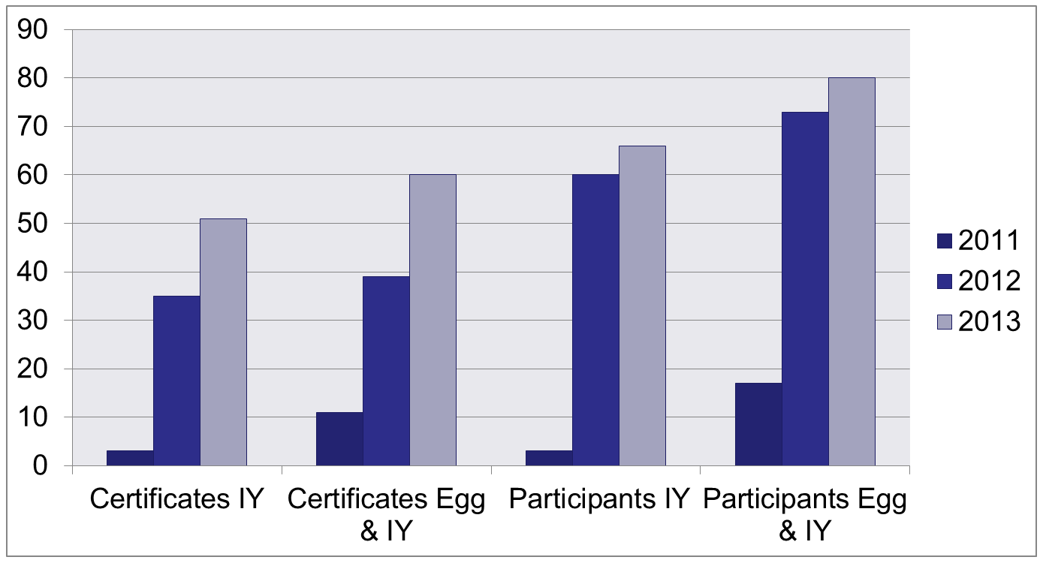
I.Y. & E.G.G. Parenting Classes
 | 2011 | 2012 | 2013
Certificates IY | 3 | 35 | 51
Certificates Egg & IY | 11 | 39 | 60
Participants IY | 3 | 60 | 66
Participants Egg & IY | 17 | 73 | 80
28

Slide 29
Program Success
Creative Partnerships
Strong Rationale & Clear Objectives
Well articulated model
Flexible funding streams

Slide 30
Funding So Far….
Library & Literacy Volunteers Regular Budgets
UPK Allocation & Priority Grants
RACF Wayne County Endowment Fund
21st CCLC Grants
SSHS Grants
Fiscal Partnership– sponsorship from businesses
Individual donors
Foundation Aid,

Slide 31
Program Success
Creative Partnerships
Strong Rationale & Clear Objectives
Well articulated model
Flexible funding streams

Slide 32
Key Learning
Sometimes (maybe often)….
Academics can eclipse rather than enlighten
Schools are focused on school
Agencies frequent silos\
So…
Engagement is critical
Lead, do not wait to be led

Slide 33
How to Drive a Perfectly Good Honda Civic into the Ground
…or the work and its expansion

Slide 34
Stories of Success
In School
Volunteer Readers in Classrooms
Book Give-Aways at school
With Family
Family Fun Literacy Nights
Literacy & Numeracy Activities & Stories
With Community
Our Community Reads Events
Thematic learning centers
Occurs Weekly
Healthy Snack
Book Give-Aways
Occurs Monthly
Healthy Snack
Book Give-Aways
Occurs monthly or bi-monthly
Bookmarks sent home that have Family Fun Literacy dates & times

Slide 35
Hula-Hoops, Yogurt and Frozen, Oh My!
…or what Our Community Reads looks like in Newark

Slide 36
Why it’s So Great
Promote Early Literacy
Book Ownership
Strengthen Community Connections
Exposing new faces to the wonders of the public library

Slide 37
Components of OCR
Library Events
PJ Storytimes, regular storytimes
General library programs you’re already doing
School Events
Open houses, standalone events, weekly school readers
Community Events
Local businesses and organizations

Slide 38
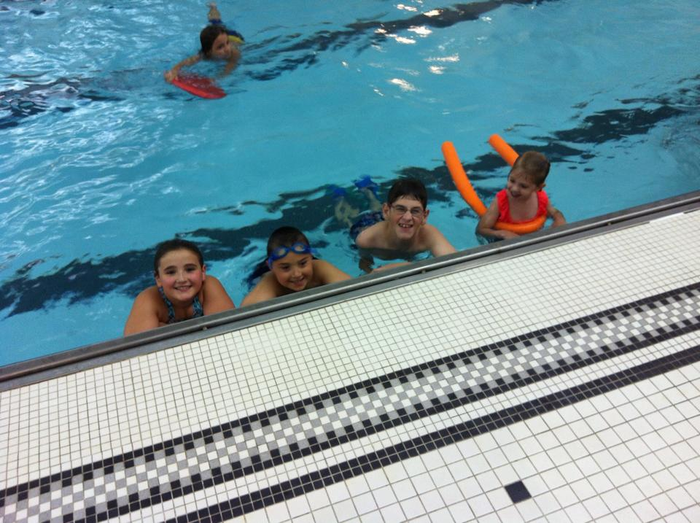
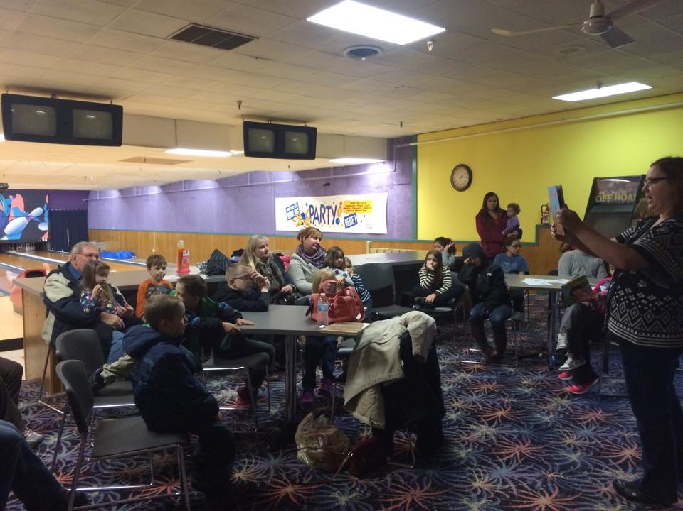
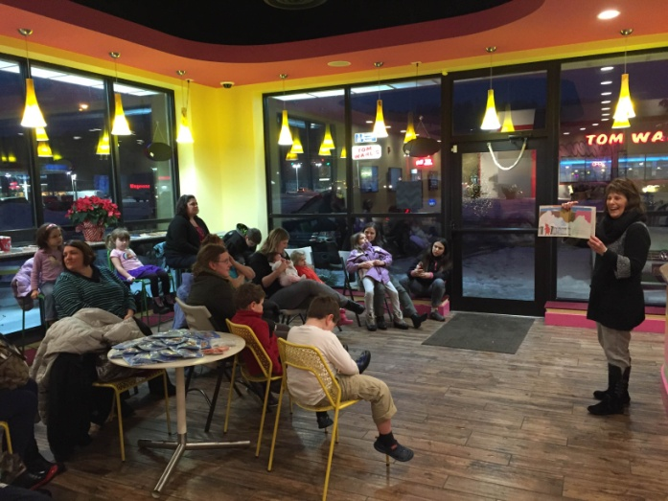
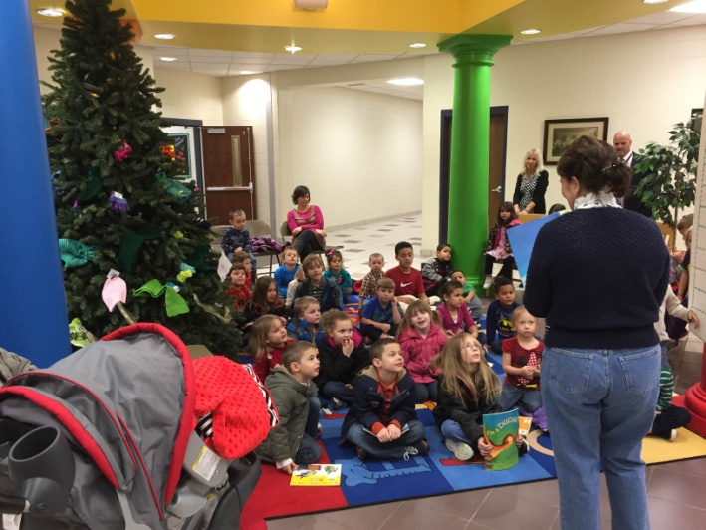
School and Community Events
High School Pool Luau
Rosebowl Lanes
Raspberry’s Frozen Yogurt
Perkins School Grade Level Night

Slide 39
Simple Program Style
Simple is best!
Easy to organize and adapt to large/small crowds
Entice them with what’s important, leave out the bells and whistles
Storytime
Free Books
Craft/Activity
Snack (if possible)

Slide 40
Promotion
School Personnel
Rotary and other service clubs
They value literacy and love volunteering
Chamber of Commerce
Mailings/Phone Calls
Sandwich Board
For month-long display at business sponsors

Slide 41
What You Need to Start OCR in Your Community
Team
Team Leader- coordinates it all and serves as the main contact person
Volunteers- brainstorm ideas, help plan and run programs, recruit sponsors/volunteers
Contacts at schools
Principals, Superintendent, Librarians, Teachers
Library programs
You’re already doing these!
Books, craft supplies, snacks
Donations, Literacy Volunteers

Slide 42
Questions?
Feel free to contact us!
Krystina Hardter
Youth Services Director
Newark Public Library
khardter@pls-net.org
Caitlin Simonse
Youth Services Librarian
Newark Public Library
csimonse@pls-net.org

