Slide 1
A Stroll Through JOBNOW!
By: Chris Finger

Slide 2
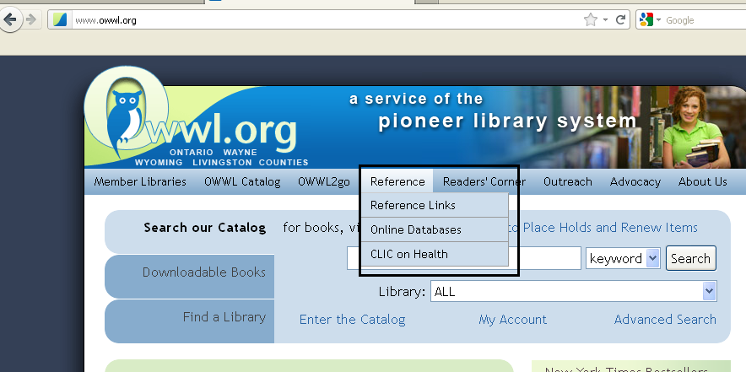
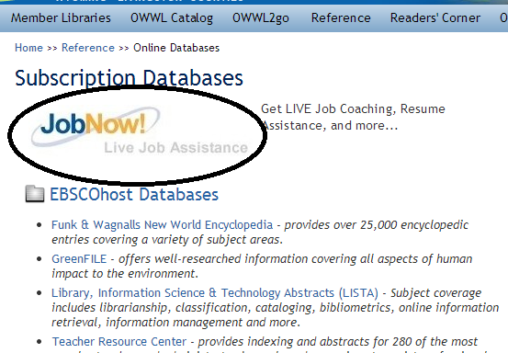
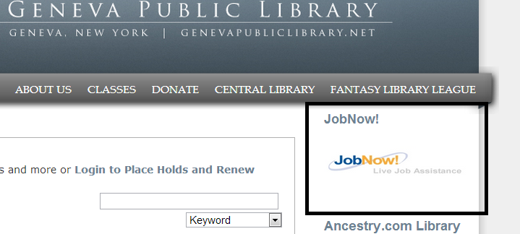
Getting Started

Slide 3
JobNow! Homepage

Slide 4
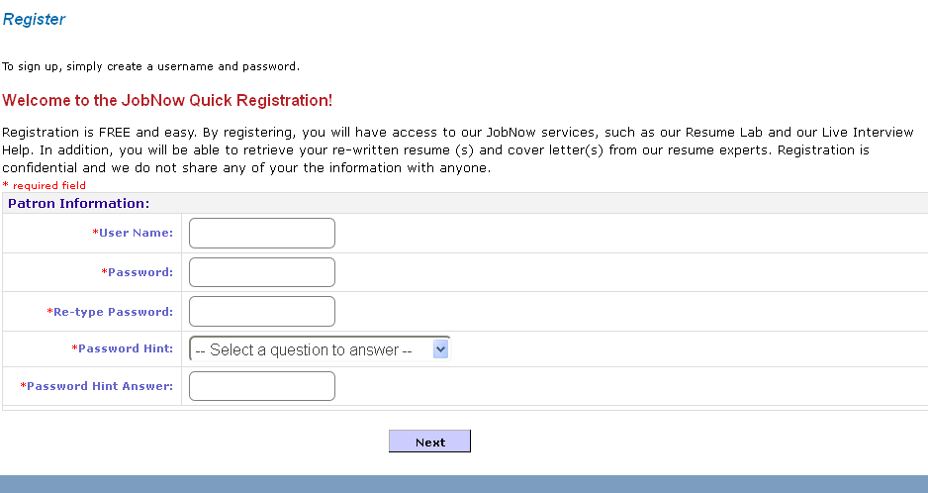
Logging In/Creating Accounts
No Email Necessary!

Slide 5
The Resources

Slide 6
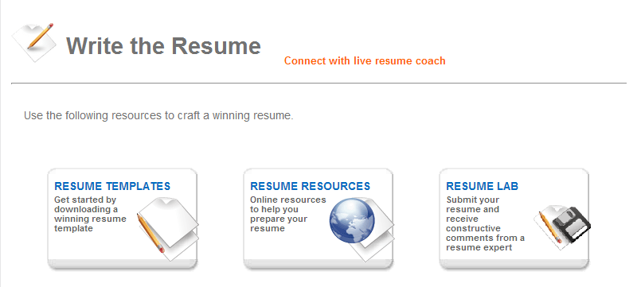
Write The Resume

Slide 7
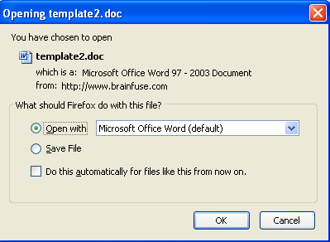
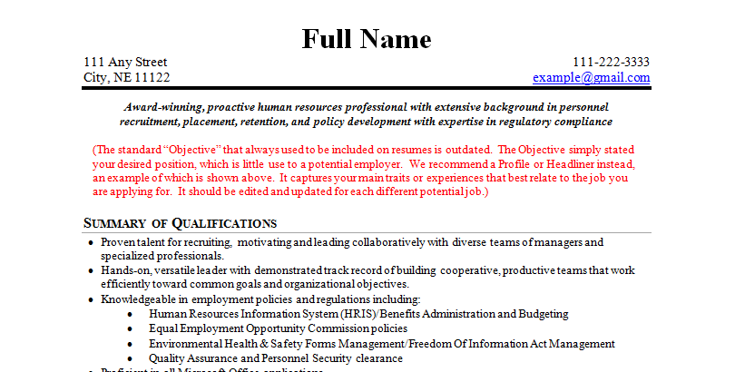
Resume Templates

Slide 8
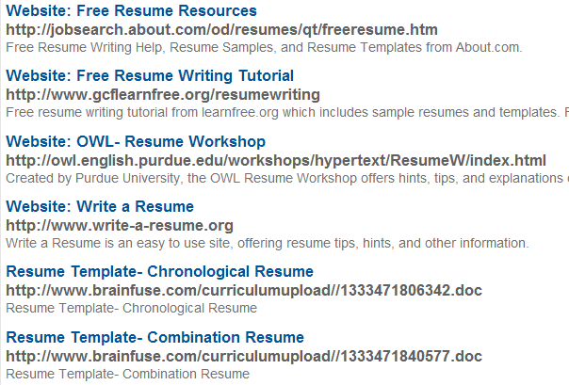
Resume Resources

Slide 9
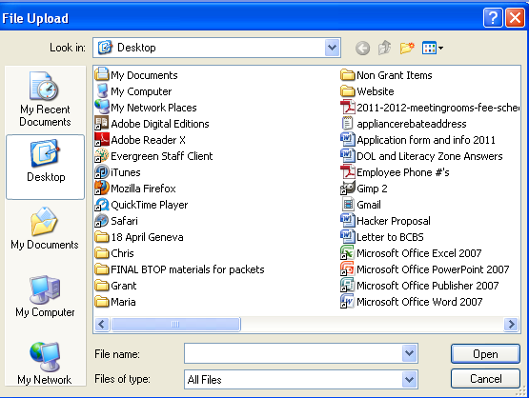
Resume Lab

Slide 10
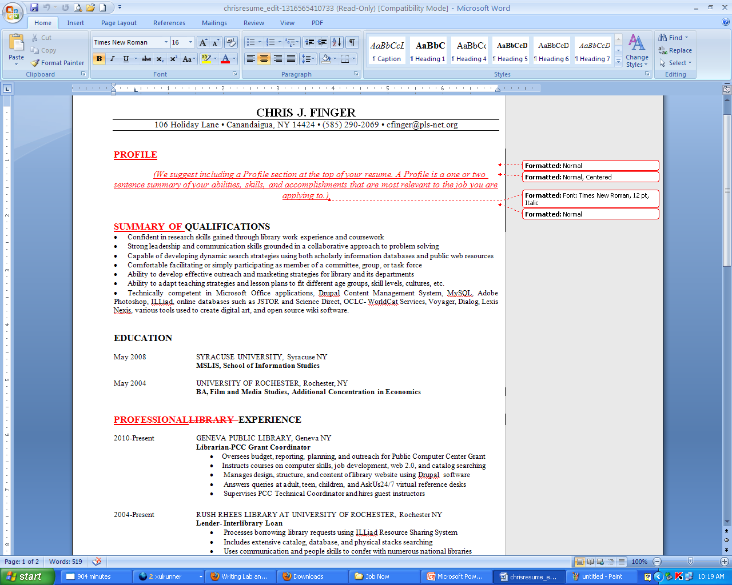
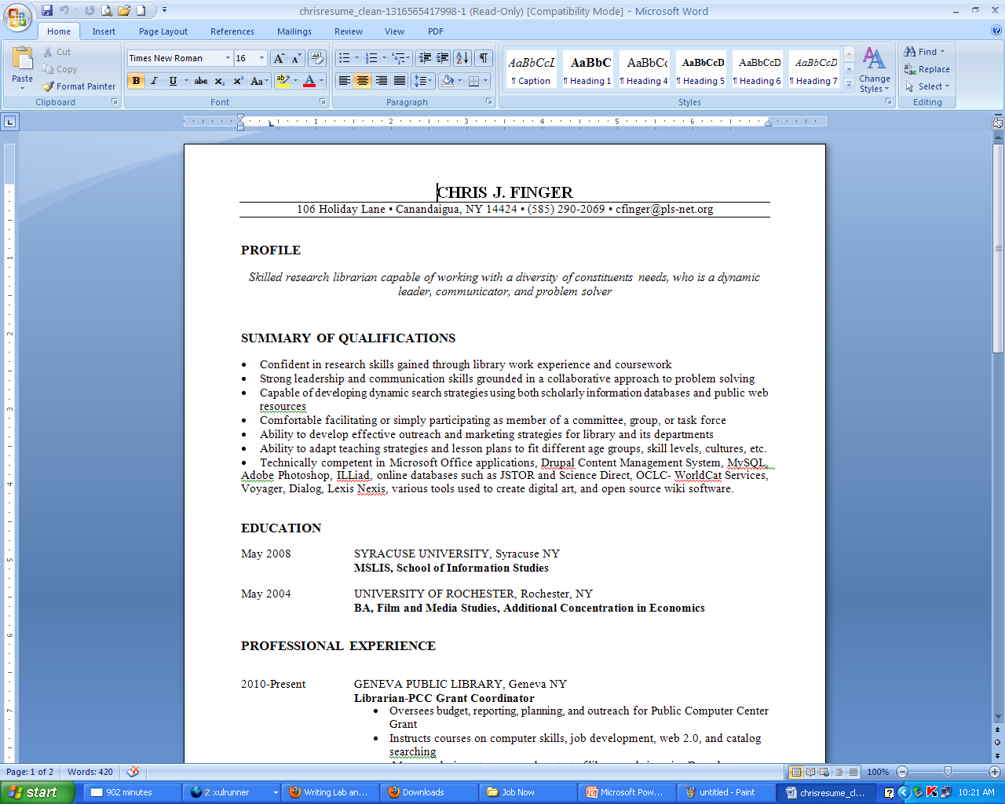

Slide 11
Ace The Interview

Slide 12
Interview Resources

Slide 13
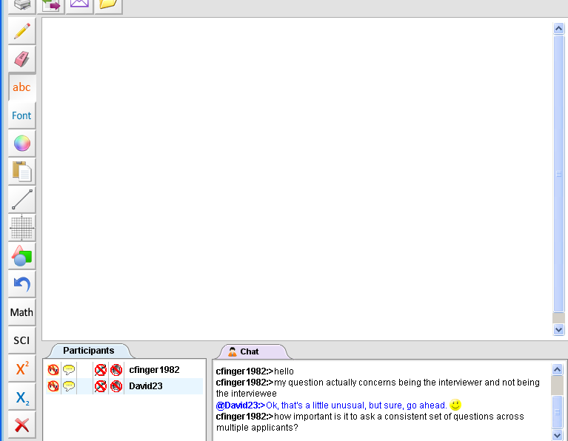
Live Interview Coach

Slide 14
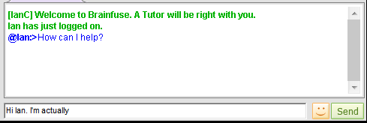
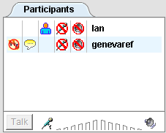
The Chat Screen Tools

Slide 15
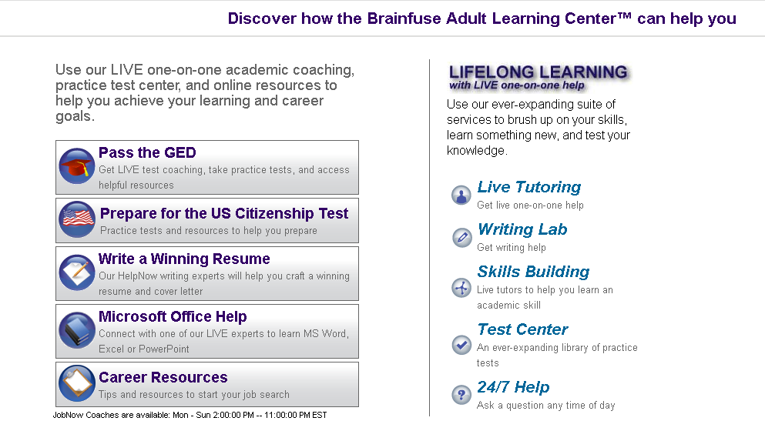
Adult Learning Center
Duplicate of the Resume Section Previously Shown
Duplicate of the Job Links Section

Slide 16
Pass The GED

Slide 17
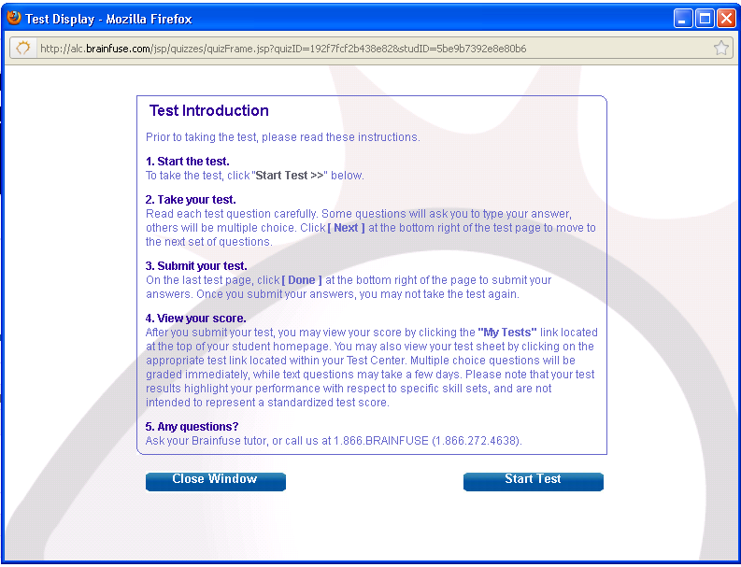
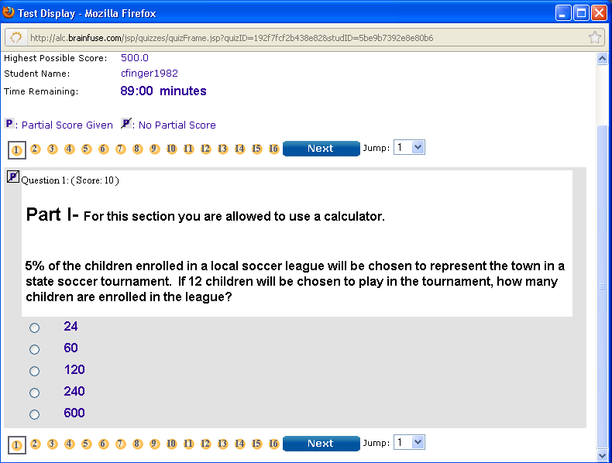
GED Practice Tests

Slide 18
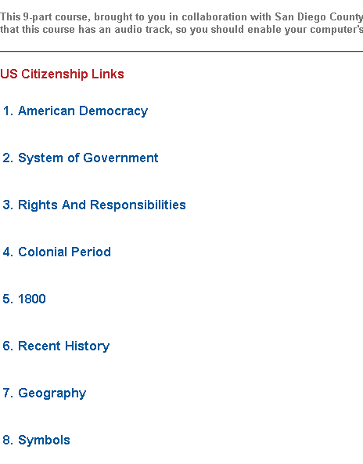
US Citizenship Test

Slide 19
Microsoft Office Help

Slide 20
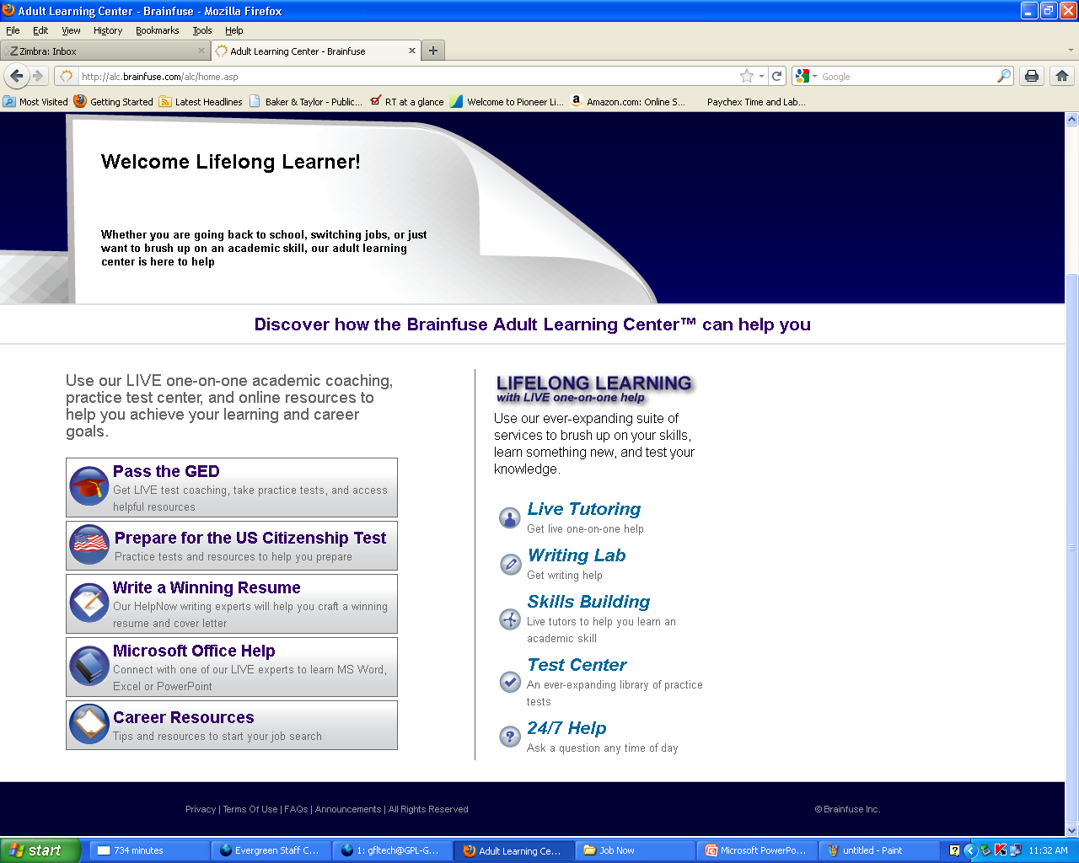
Lifelong Learning

Slide 21
Live Tutoring

Slide 22
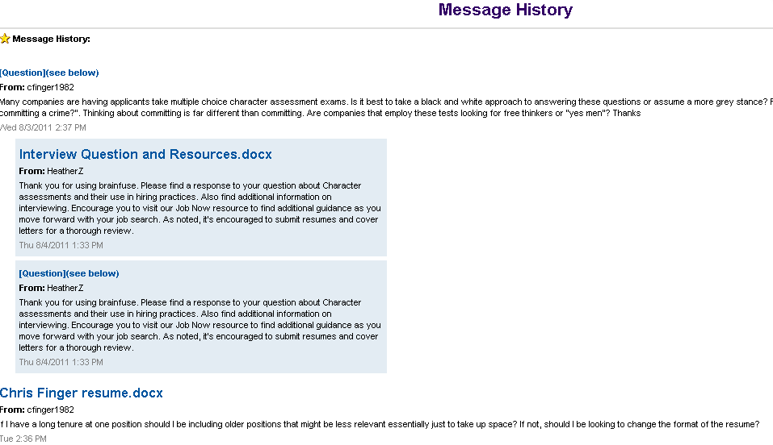
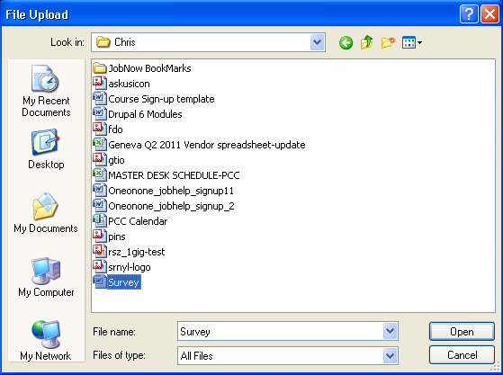
Writing Lab

Slide 23
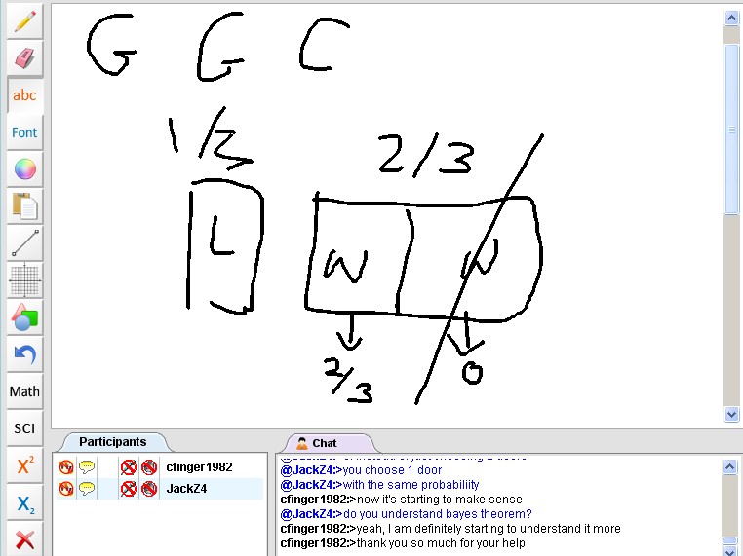
Skills Building

Slide 24
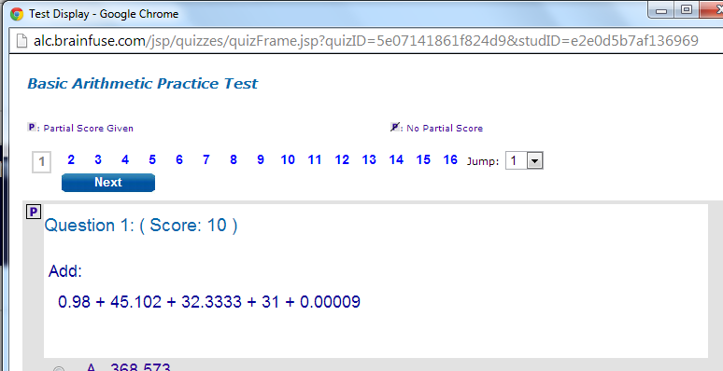
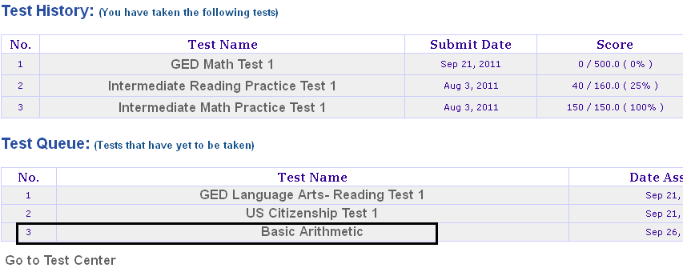
Test Center

Slide 25
24/7 Help
Why is the sky blue?

Slide 26
Past Sessions

Slide 27
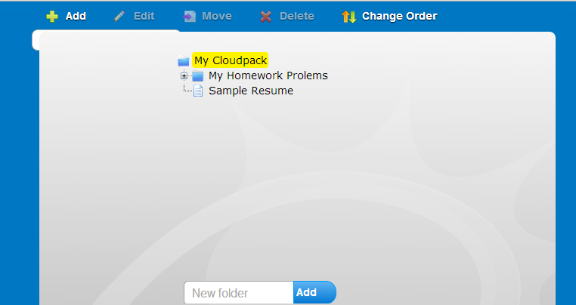
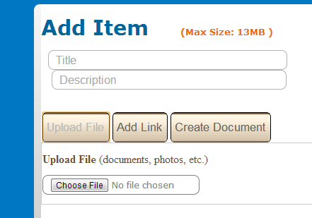
My Cloudpack

Slide 28
Assessment of JobNow!
Strengths:
Test banks- basics, GED, citizenship
Live tutoring, job coaching
Resume/document critiques and question answering
No question is treated as obvious
Coaches are not pedantic
Good career resource links
Weaknesses
Links for Office, resume materials, interviews, and career assessments are poor
No morning tutoring hours

Slide 29
Ideas moving forward
Make your Library the middleman and help patrons identify the JobNow tools with you instead
After school homework lab using JobNow
Use JobNow tests as evaluation metrics for your computer classes
Citizenship, GED, or general “Stump the Expert” programs
Free editors for authors
outsource reference questions to JobNow

Slide 30
Trivia and Prizes
Who can name the 4 primary sections of JobNow visible on the home screen?
What did I mention was not needed to create an account?
What is the name of JobNow’s cloud based file storage tool?
Which of the following was not listed as a career suggestion after I completed a career aptitude test through JobNow?:
sports agent, gaming manager, kindergarten teach, librarian

