Slide 1
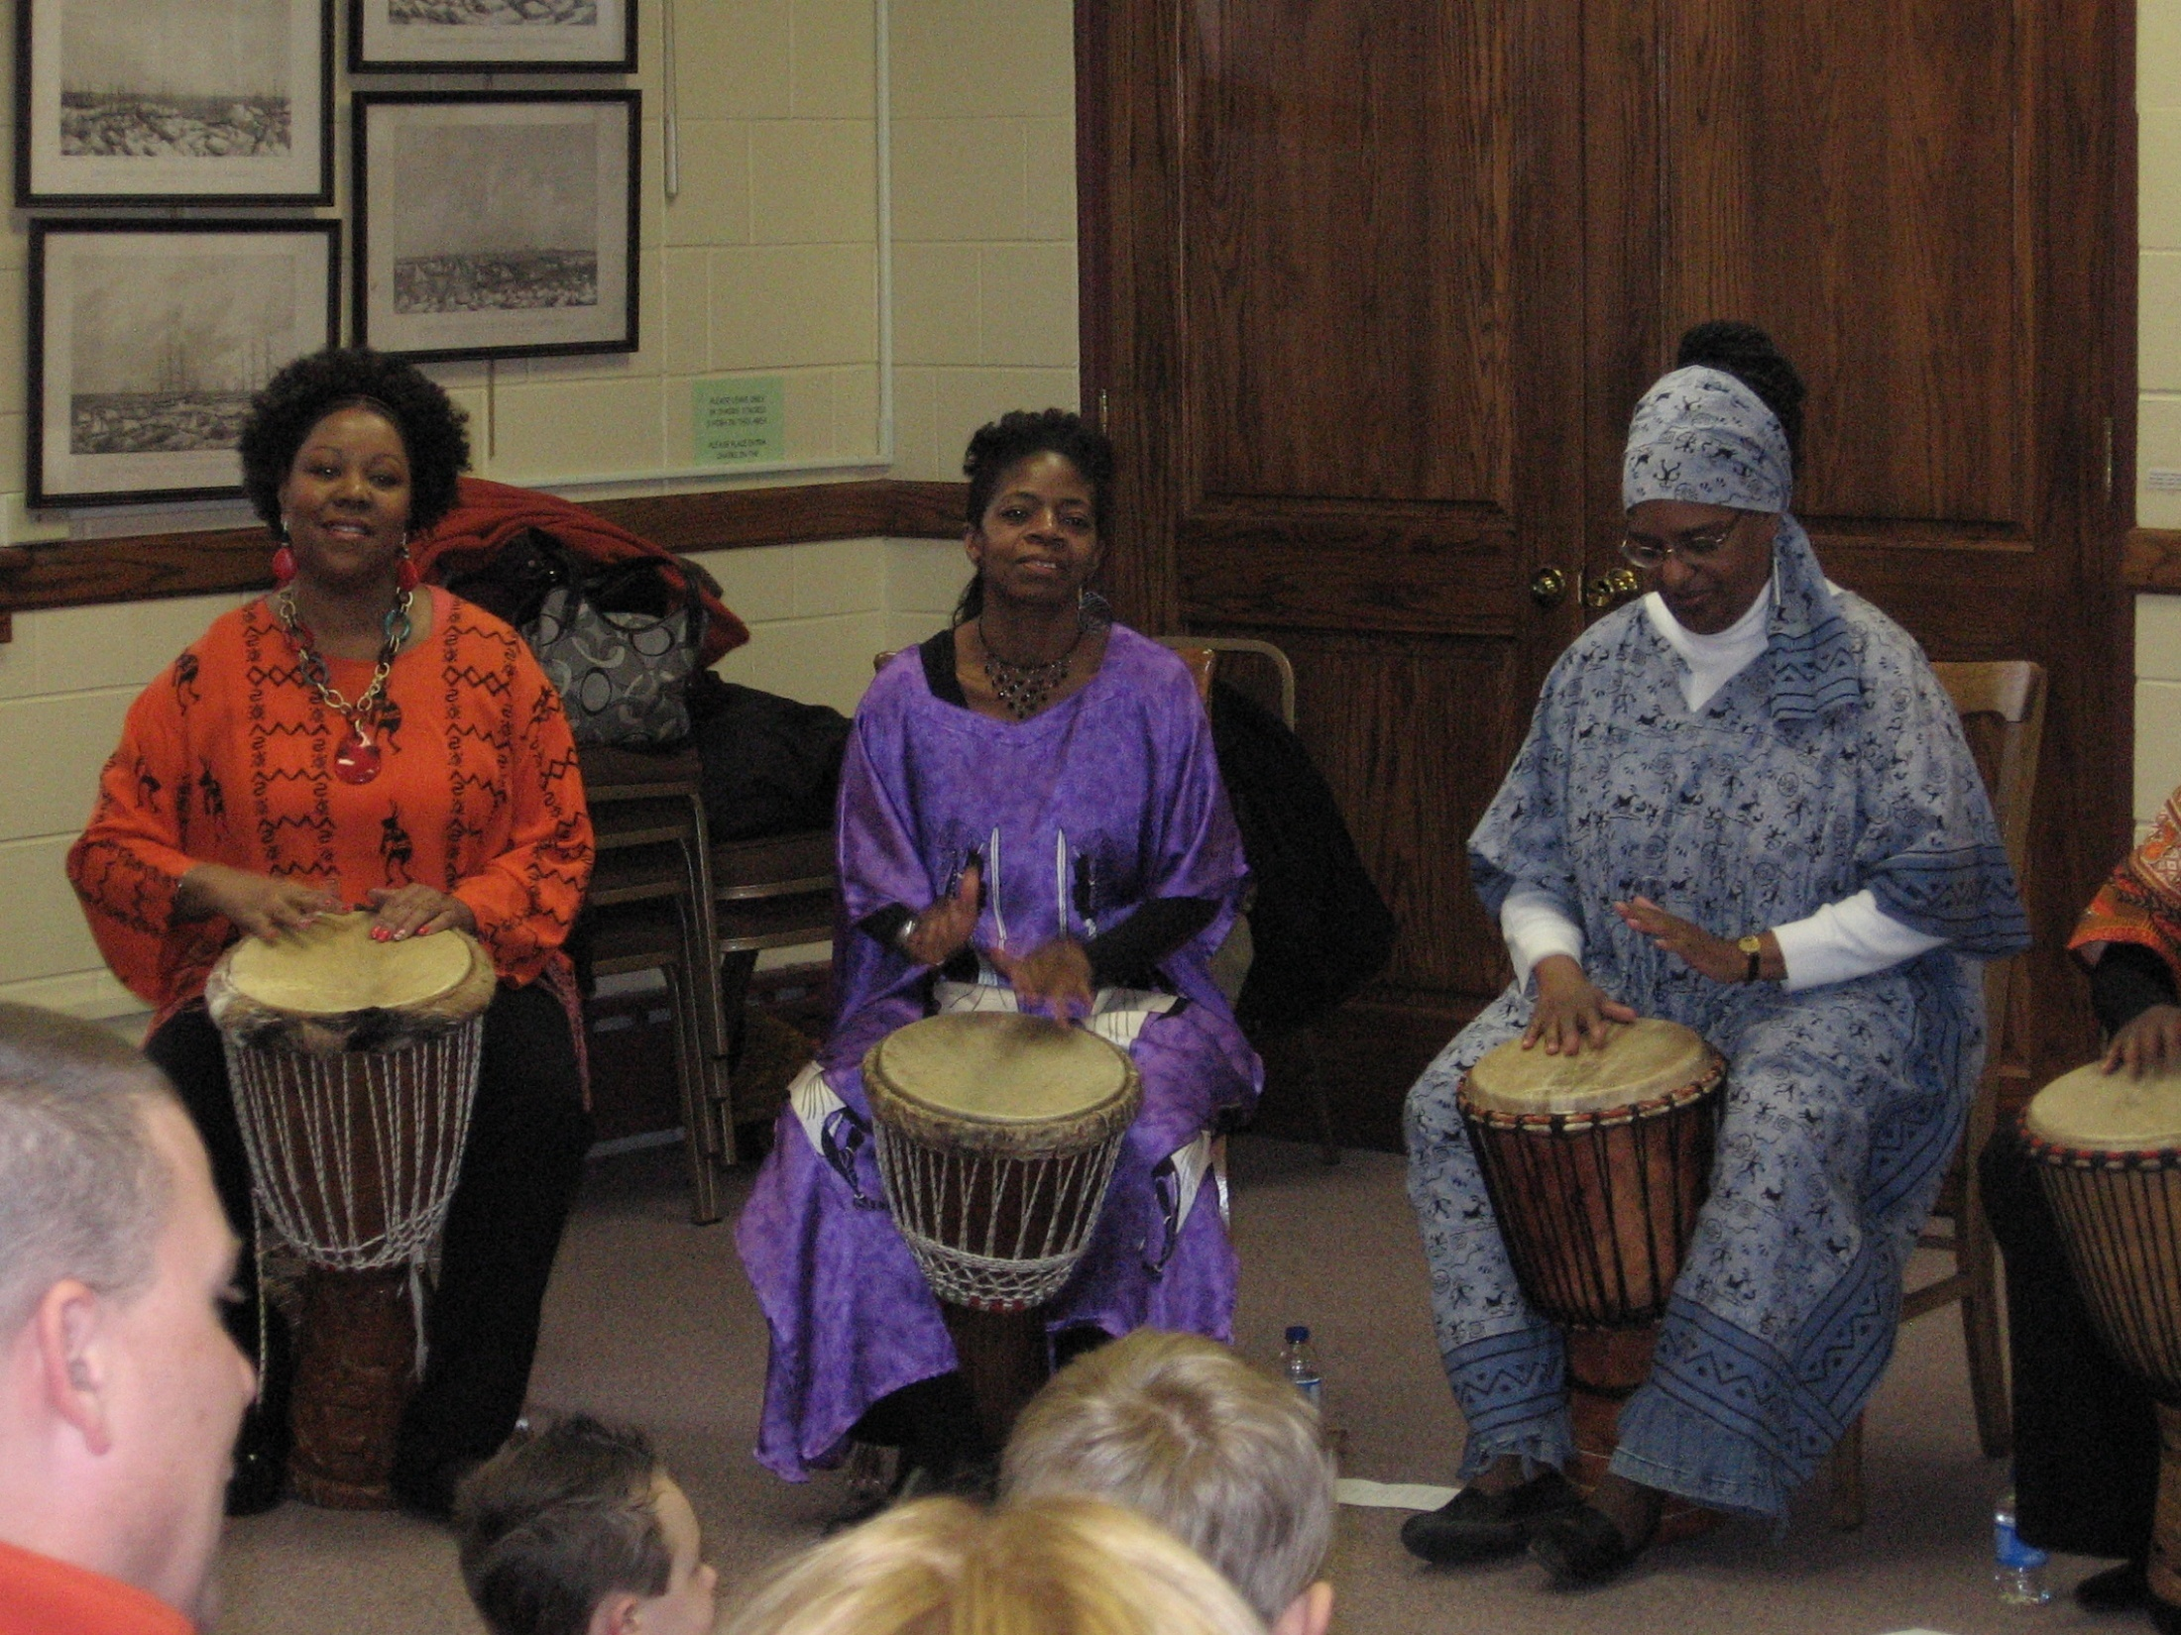
creativedaughters@yahoo.com

Slide 2
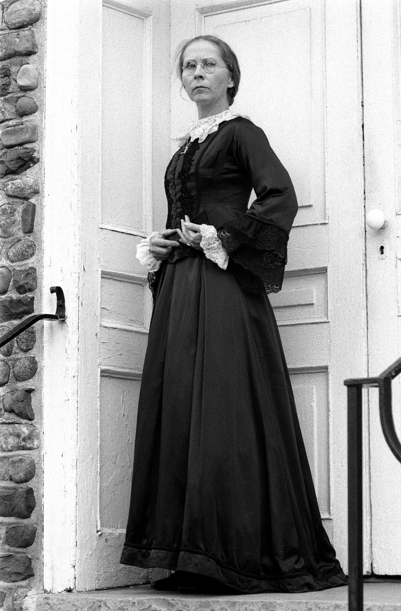
www.gretchensepik.com

Slide 3
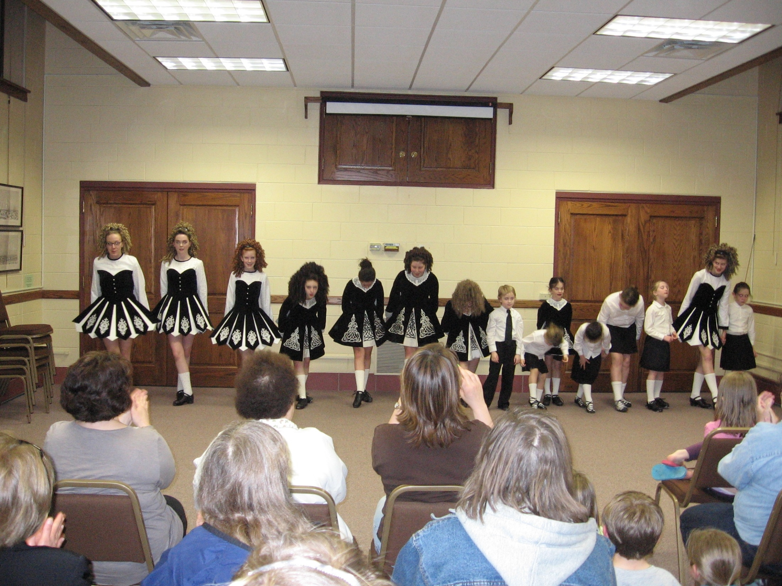
youngschoolirishdance.com

Slide 4
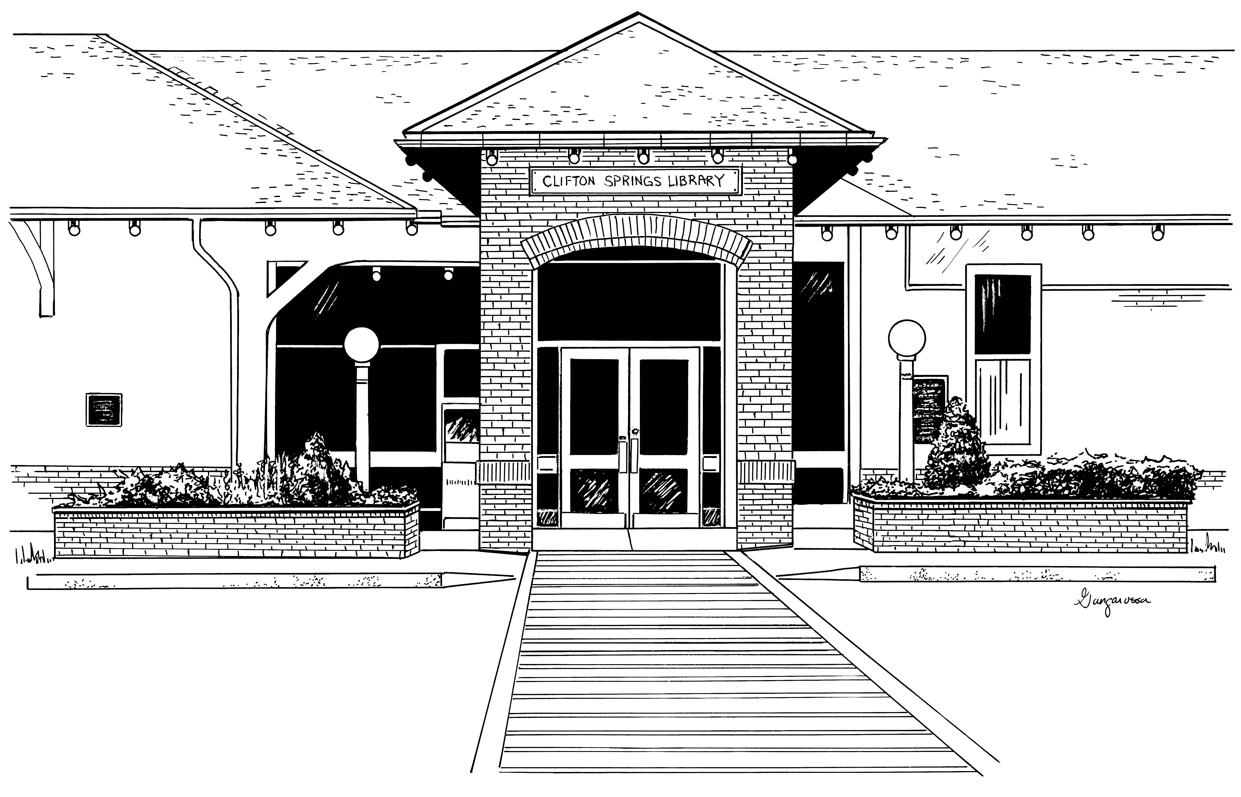
National Library Week
2011
Why I love my library...
Sincerely,
________________________________
(your first name)

Slide 5
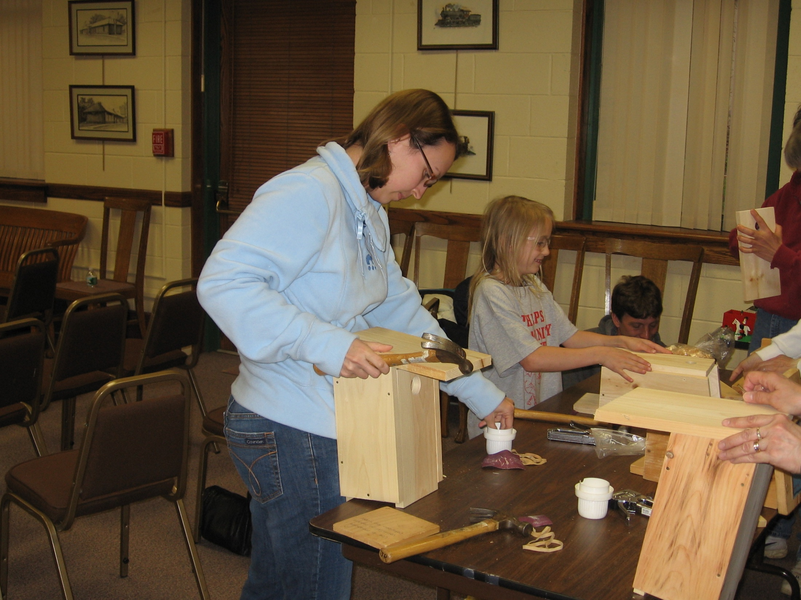
bluebirdprograms@aol.com

Slide 6
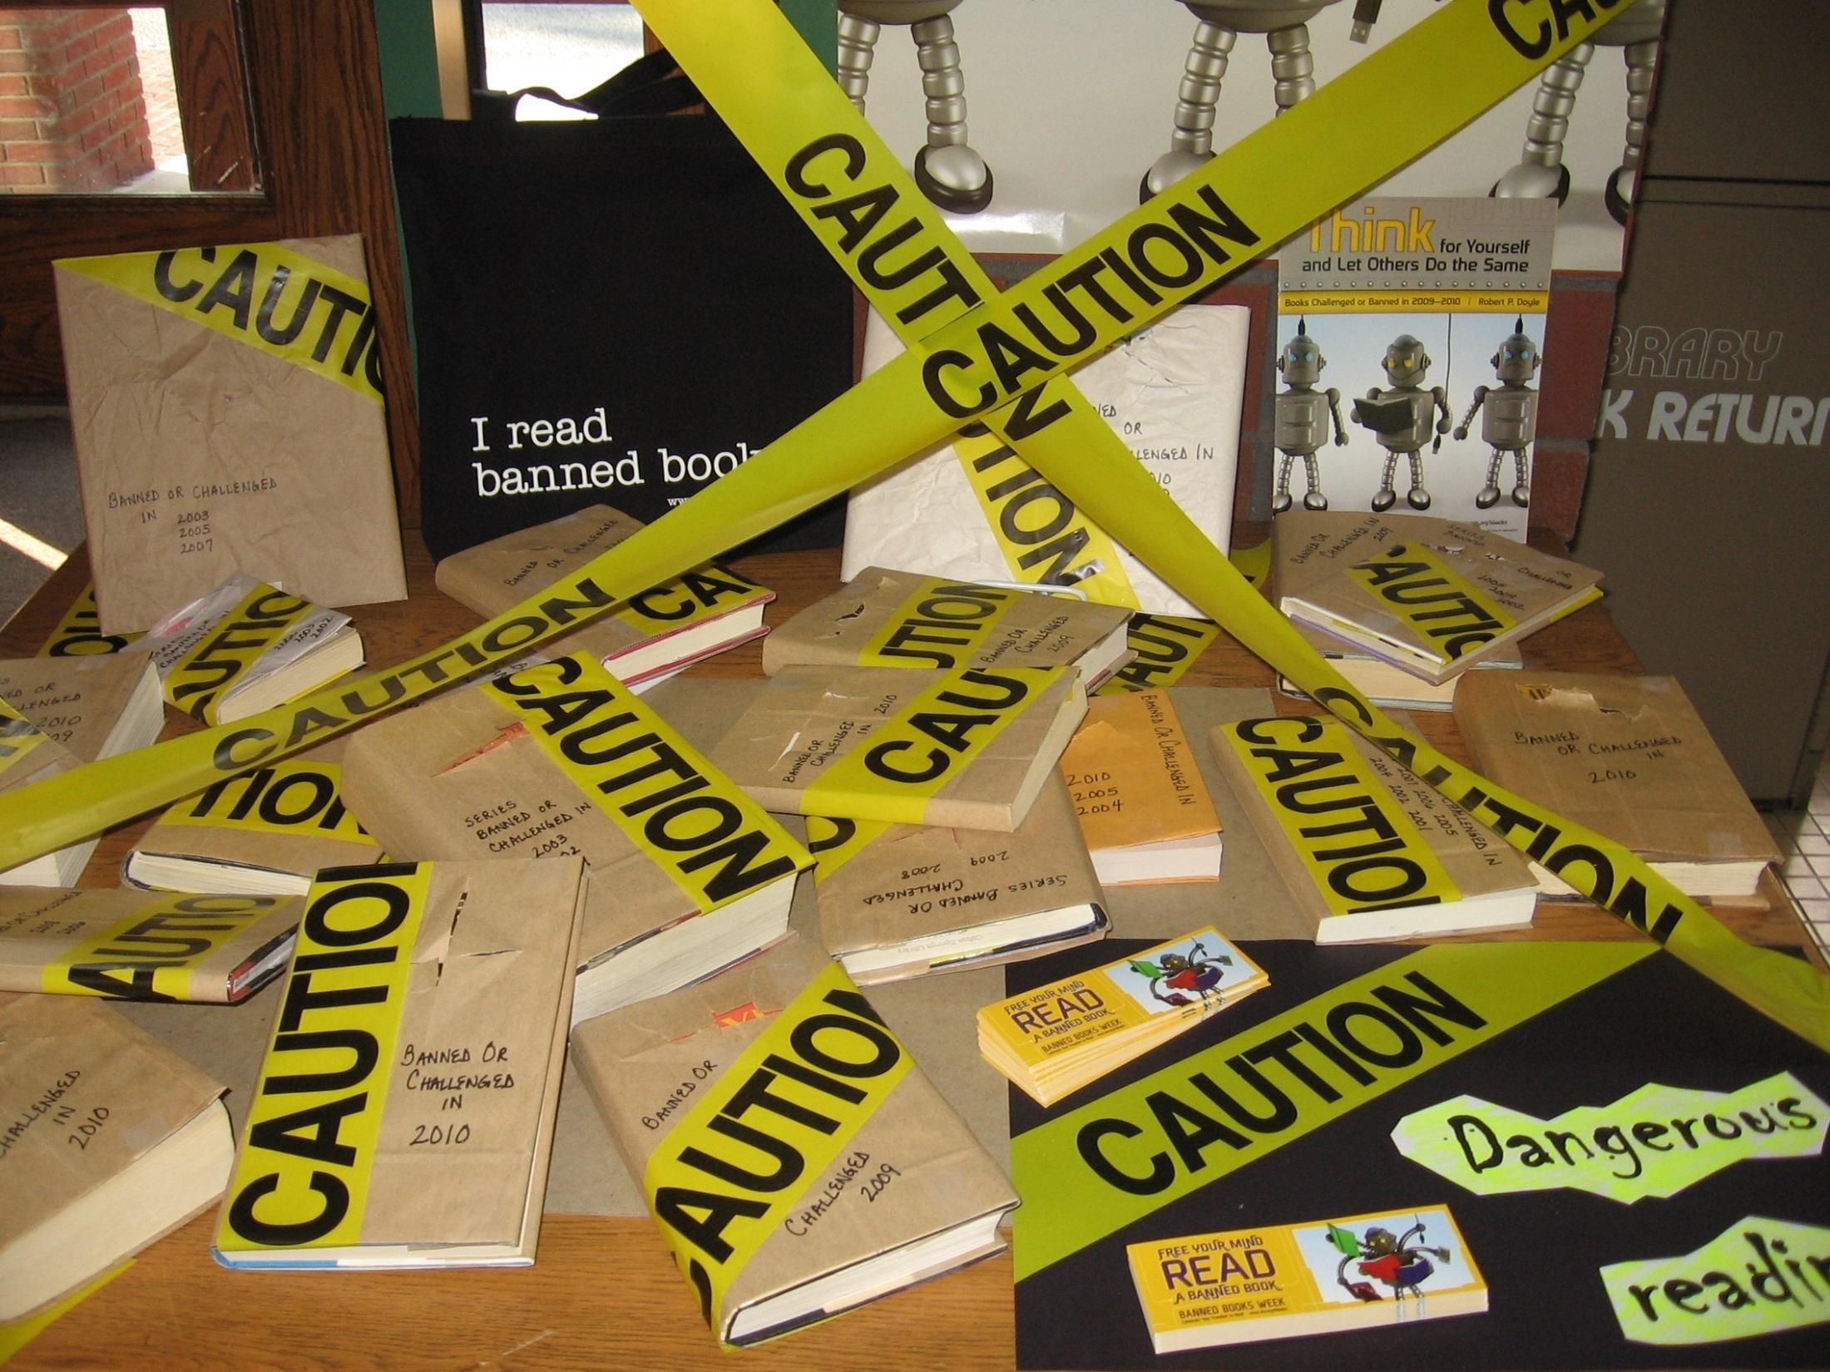

Slide 7
