Slide 1
What to read after
Stieg Larsson (RIP)

Slide 2
Or
What is
Nordic Noir
or
Scandi Crime Lit
?

Slide 4
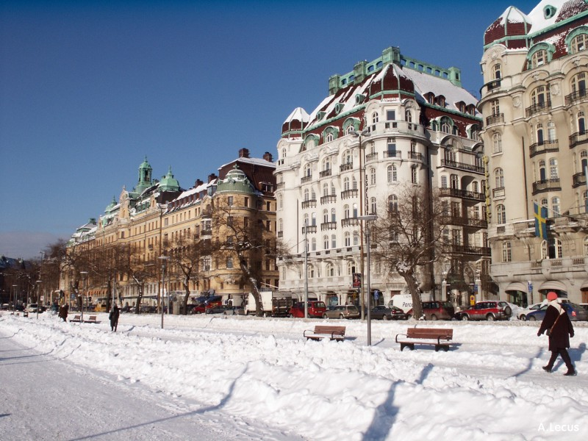

Slide 5
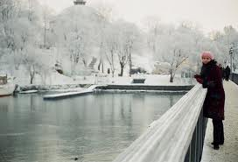

Slide 6
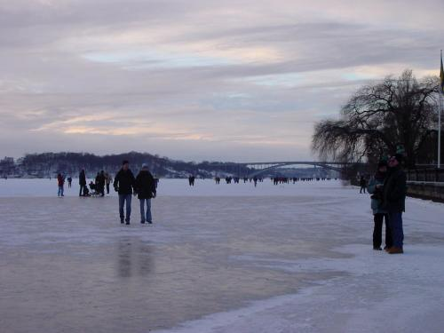

Slide 7
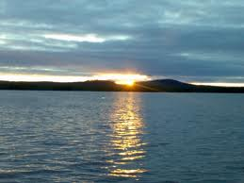

Slide 9
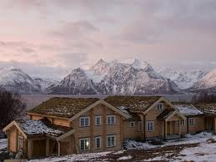

Slide 10
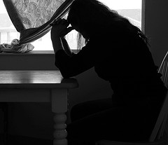

Slide 11
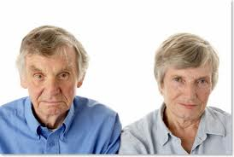
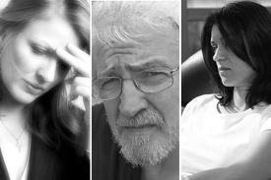
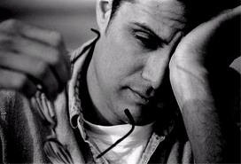
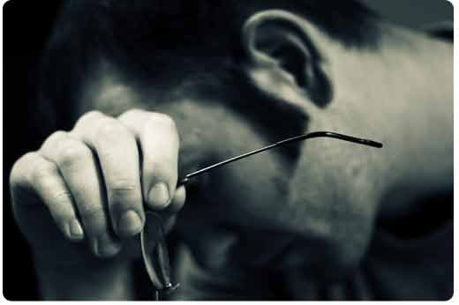
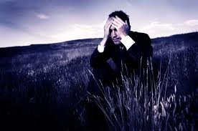
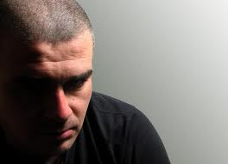
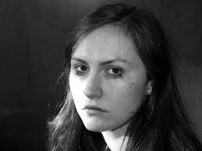
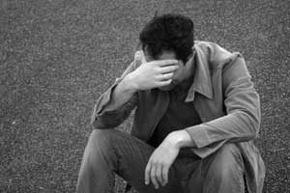
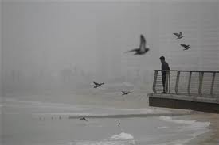

Slide 12
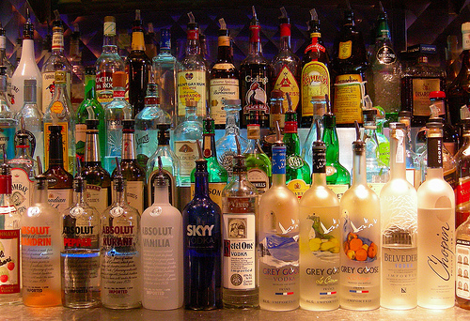

Slide 17
Lots and lots of

Slide 18
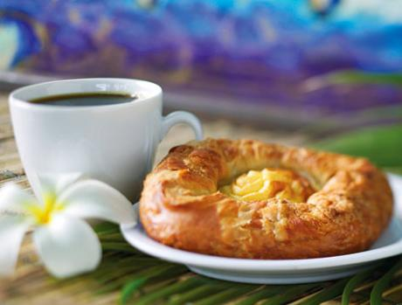
Along with carbs will encourage people to talk

Slide 21
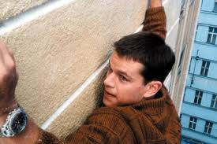

Slide 23
International Bestseller !

Slide 24
Do not Feature are not

Slide 25
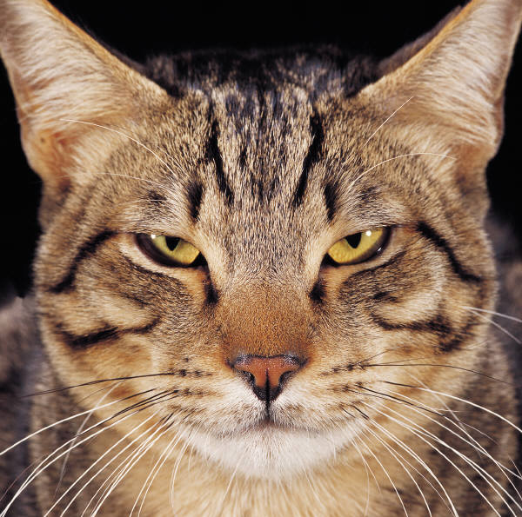

Slide 28
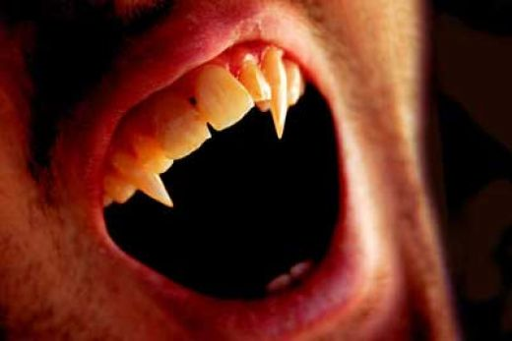

Slide 30
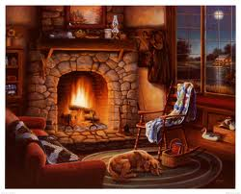

Slide 31
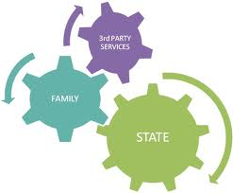
Reoccurring themes
Social Welfare System
Nazism in History

Slide 32
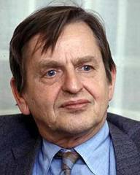
Other contributing factors
Olof Palme’s Assassination (1986)
Space
Urban crowding
Apartment size
US: 2,300 sq. ft. Denmark: 1,475 sq. ft.
Open space in the country
Summer cottages
Outdoors

Slide 33
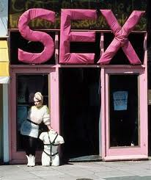
Sometimes characterized by

Slide 34
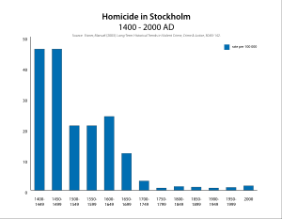
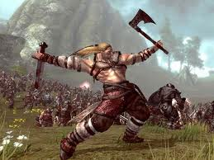
Violence

Slide 35
What is the Appeal?
National Readers
International Readers

Slide 36
Appeal Elements
Tone
Atmospheric
Bleak
Moody
Suspenseful
Disturbing
Menacing
Melancholy
Writing Style
Gritty
Ironic
Compelling
Literate
Storyline
Character-driven
Intricately plotted
Strong sense of place
Violent
Realism
Concern for social issues
Pace
Relaxed
Deliberate
Fast-paced
Better read than listened to

Slide 37
Who to read after Stieg Larsson?
Karin Alvtegen
Ake Edwardson
Karin Fossum
Anne Holt
Arnaldur Indridason
Lars Kepler
Asa Larsson
Camilla Lackberg
Henning Mankell
Jo Nesbo
Hakan Nesser
Anders Roslund
Maj Sjowall
James Thompson
Gunnar Staalesen
Yrsa Sigurdardottir
Helene Tursten
With thanks to the members of the Scandinavian and Nordic Crime Fiction Group On Goodreads.com for a very comprehensive list of authors.

