Slide 1

Beth, Betsy, Ellen & Wendy present Highlights from

Slide 2
Ellen … in absentia

Slide 3

User profile
Who are your users?
  77% female
  47% between the ages of 40-59
  Household income: 65% earn greater than $60K.
  Education level: 78% have completed a 2 or 4 year college degree or higher.
  30% rarely or never visit the physical library but use digital downloads regularly.
Who do you need to target?
  Males
  Children, young adults, twenty-somethings (combine for only 12%)
  Non library card holders
Wow! That was an eye-opener. Our customer service and readers’ advisory skills need to shift to get the under 40’s.
Notes:
Wow. That was an eye-opener. Our customer service and readers’ advisory skills need to shift to get the under 40’s

Slide 4
Give ‘em what they want now how do we give them what they want?
Build a Strong dynamic downloadable collection and site (Order Often)
Ongoing Staff Education
Ongoing Public Promotion
Incorporate eBook promotion in everything we do.
And from another session: Order often. Most people only look at the New Book Shelf area – the most recent additions.
Notes:
And from another session: Order often. Most people only look at the New Book Shelf area – the most recent additions

Slide 5
TRAIN STAFF TO ASK:
“Would you like me to see if the wait for the e-book is shorter?”
Ask “What format would you like this in?” Another perceptual shift we need to make.
Believe it or not, there are still people who don’t know you even offer e-books.
Notes:
“Ask What format would you like this in?” Another perceptual shift we need to make.

Slide 6
Order often!
Some patrons only browse the *NEW* books.
Order fewer books more often to keep patrons
coming back.

Slide 7
Beth …
Improvise – Adapt - Overcome

Slide 8
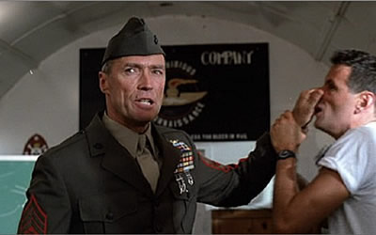
You're Marines now. You adapt. You overcome. You improvise. Let‘s move. Four minutes!
Take your post. The Marines are looking for a few good men. Unfortunately you ain't it. We will blaze a path into battle for others to follow. Surrender is not in our creed. Let me here you say that.
Notes:
Play video until 1:17

Slide 9
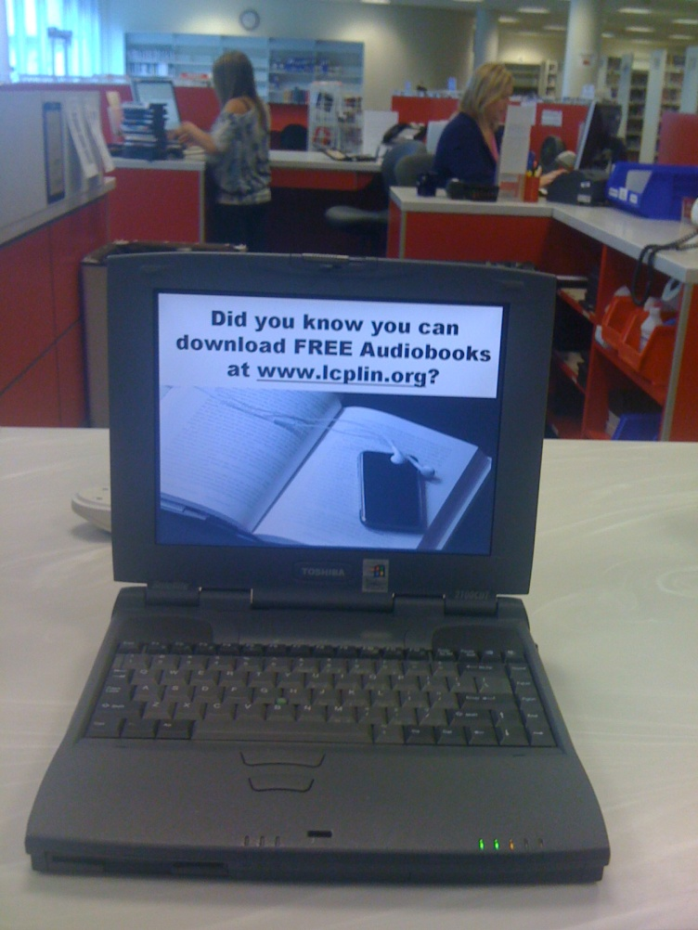
Time to get CrEaTiVe!!
IMPROVISE
A laptop running Windows 98 is magically turned into:
“digital signage” using PowerPoint.
Notes:
IMPROVISE:
Creative programming, promotion, and support – “Go Box” for festivals/community events, Petting Zoo, recruit patrons and their devices, digital signage, monthly newsletters of new titles/programs, partner with Sony/Barnes & Noble/Staples/fitness centers or YMCAs, “this card entitles you to __ free ebook downloads at your library” cards, use facebook & twitter and other social networking tools, other crazy ideas…

Slide 10
When will eBooks become dominant?
ADAPT
  Timeline:
  April, 2003: First OverDrive eBook site.
  November, 2007: First Kindle™ released.
  July, 2010: Amazon’s Kindle eBooks outsell hardcover for the first time.
  January, 2011: Amazon's eBooks outsell paperbacks for the first time.
  Q1 2011: eBooks comprised 22% of sales in the U.S.
  May, 2011: Amazon’s eBook sales outdo all print combined.
  Projections:
  2013: 4 times as many copies of eBooks will sell than in 2010.
  2014: Forrester Research: eBooks to be 50% of units sold.
Source: Google Images
Notes:
ADAPT:
If half of all units sold will be ebooks, what does that mean for our physical collections? Our space? Borders is closing all of its stores… who will fill the bookstore/browsing/discovery space/café niche? Independent bookstores are making a comeback – promote backlists, support author fan-bases, etc.

Slide 11
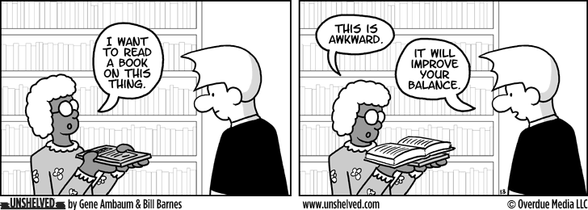
Power of knowledge
OVERCOME
You never want anyone from your library to react to a digital book inquiry like this guy!
Notes:
OVERCOME:
Stay informed, follow blogs (friend Barbara Henry on facebook), try devices, train your staff and yourself, budget for the Kindle customers, order frequently, etc.

Slide 12
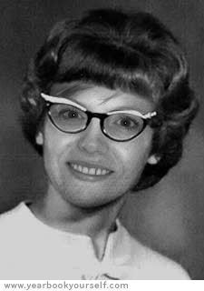
You're Librarians now. You adapt. You overcome. You improvise. Let‘s move. Four weeks!
We will blaze a path into battle for others to follow. Surrender is not in our creed. Let me here you say that.
Notes:
Kindle will be big – bigger than January 2011! And it could be here in 4 weeks….

Slide 13
Wendy …
Three Take-aways – Promote, Train, Prepare

Slide 14
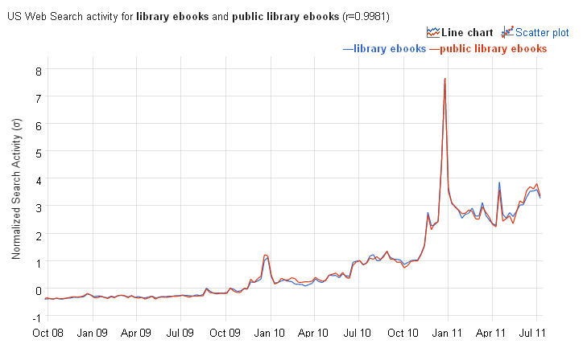
http://correlate.googlelabs.com/search?e=library+ebooks+&t=weekly

Slide 15
TRAIN STAFF TO ASK:
“Would you like me to see if the wait for the e-book is shorter?”
Believe it or not, there are still people who don’t know you even offer e-books.
Notes:
“Ask What format would you like this in?” Another perceptual shift we need to make.

Slide 16
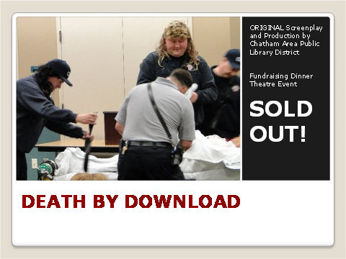
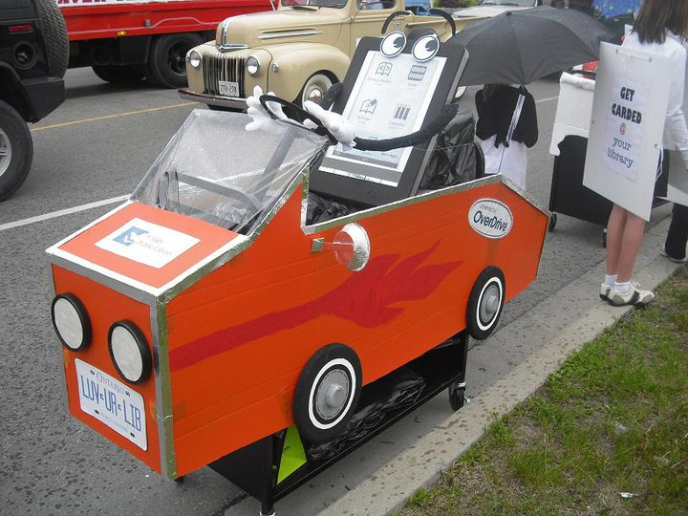
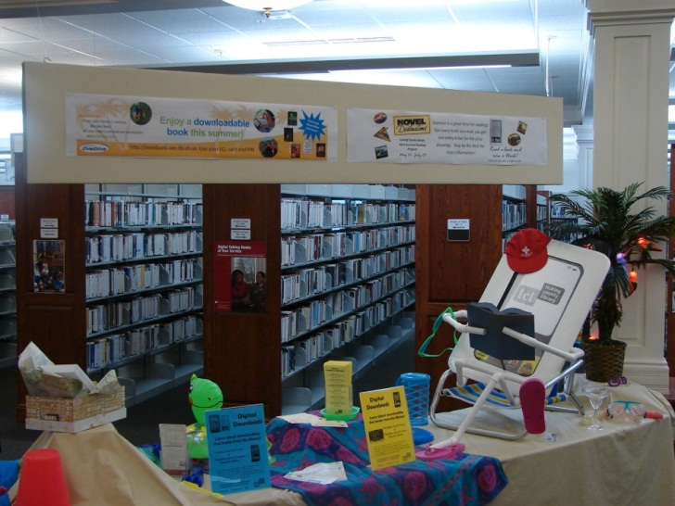
Chatham Area Public Library District (IL)
Whitby Public Library (Ontario)
Licking County Library (OH)

Slide 17
Betsy …
Favorite quote - “Adapt or die”

Slide 18
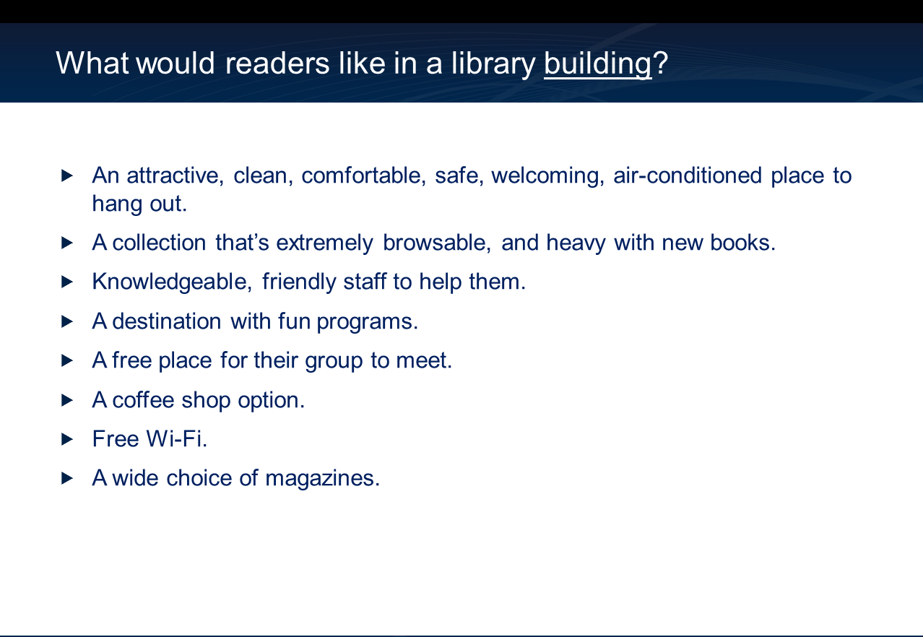
Notes:
Bookstore features – library space and place

Slide 19
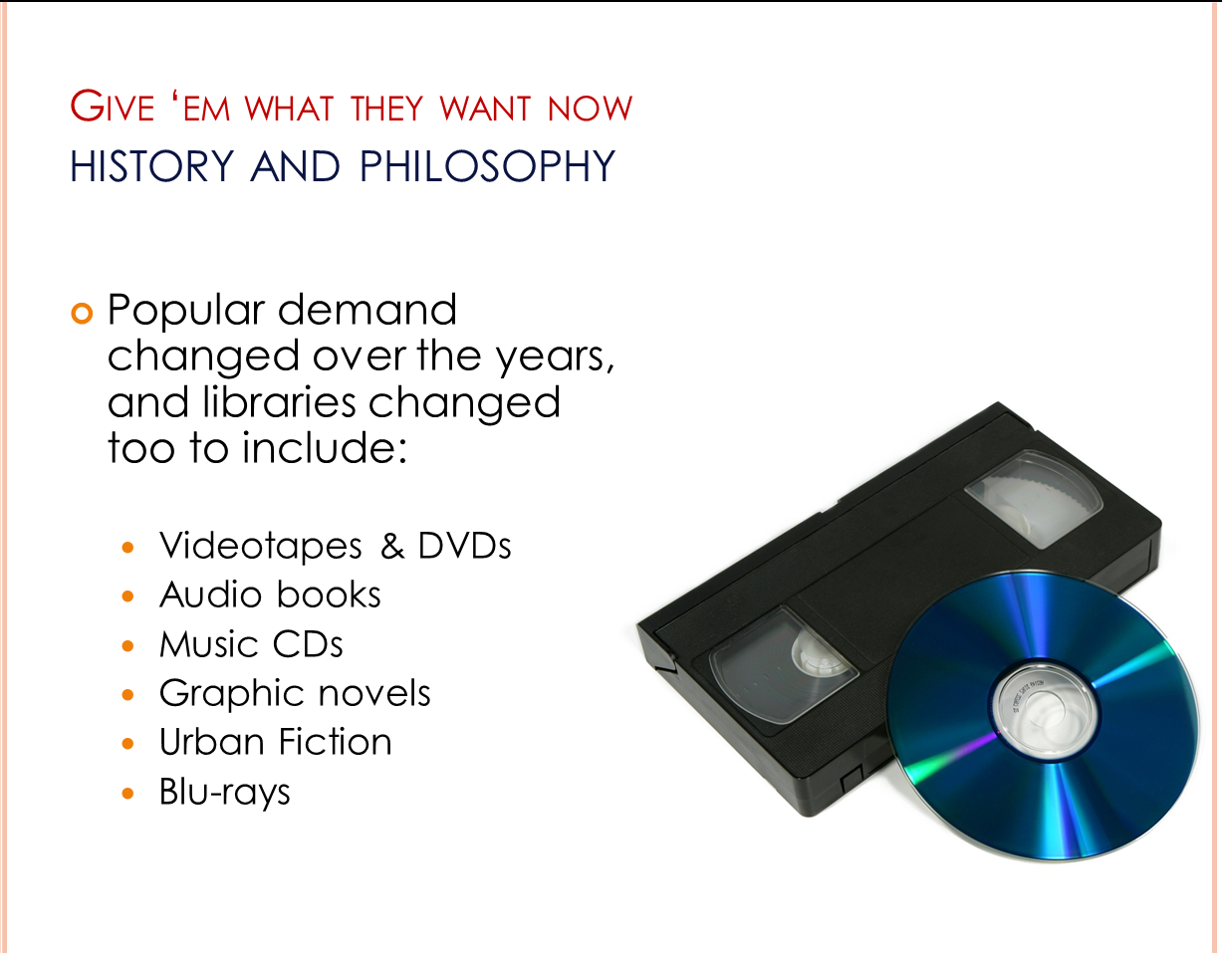
Notes:
Content development – what they want 1

Slide 20
Content is
,
Books are for use.
Every reader his [or her] book.
Every book its reader.
Save the time of the reader.
The library is a growing organism.
mostly
piece of content
user
user
currently undergoing a profound transition. Please stand by…
Michael Ciccone – Hamilton Public Library

Slide 21
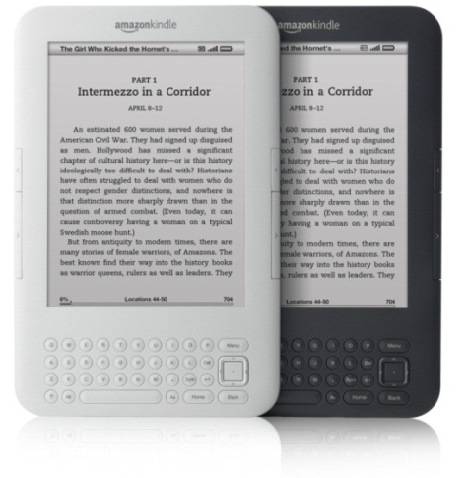
What’s next from OverDrive …
Consolidated formats for eBooks
Early return MP3 audiobooks
Renew
nook color app
Auto activation for ADE
eBook samples
Patron recommendations for purchase
ILS integration
After the …

