Slide 1
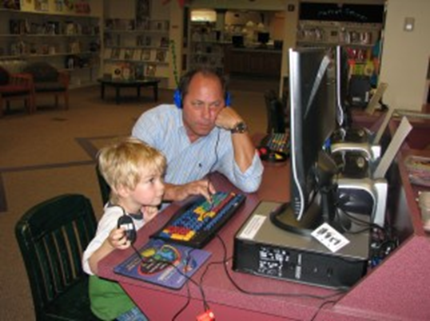

Slide 2
Easy, Low-Cost Ideas for Integrating Early Literacy Into Library Spaces
Notes:
Public libraries are uniquely positioned to connect kids with parents to further early literacy, and to help parents prepare children for school. We’re open evenings, weekends and during the summer. We have traditionally offered storytimes and other staff-led programming which people expect – and we’ll hear some really creative things that are going on in Pioneer in a few minutes.
But programs which occur at a specific time are not always convenient for working parents and overscheduled kids. With a little money, effort and creativity, public libraries can add “self-service” early literacy opportunities for parents to interact with their children.
PLA Preconference in 2008 “Children’s Spaces, Family Places: Developing Interactive Early Literacy Environments in Your Library”

Slide 3
Why?
Public Relations
Demographics
Staffing
Door Count
Notes:
Why did I want to do it?
Positioning the public library as a serious partner in the education of our children (PR, advocacy)
Lots of working parents. High poverty rates. Statistics from school district showing that kindergarten readiness was lacking.
Our busiest day was Saturday, and the Children’s Room was not staffed. Children’s librarian’s time was limited – was also staffing reference desk 12-15 hours per week (limited time for programming).
We wanted kids and parents to come, stay and return!

Slide 4
Six Early Literacy Skills
Print Motivation (interest in and enjoyment of books)
Vocabulary (knowing the names of things)
Letter Knowledge (learning that letters look different, and have different names and sounds)
Print Awareness (learning that in English we read from left to right, and from top to bottom)
Phonological Awareness (the ability to hear and manipulate the smaller sounds in words)
Narrative Skills (a child’s ability to understand and tell stories)

Slide 5
Any Space Can Be An Early Literacy Space

Slide 6
http://www.earlylit.net/libraryenvironment/hcplpla08elenv.pdf
Notes:
With thanks to Hennepin County Library

Slide 7
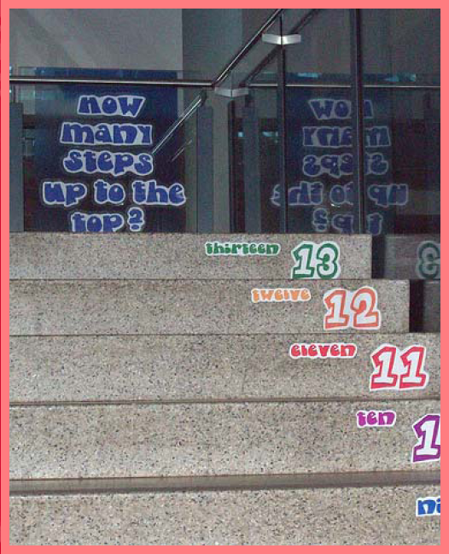
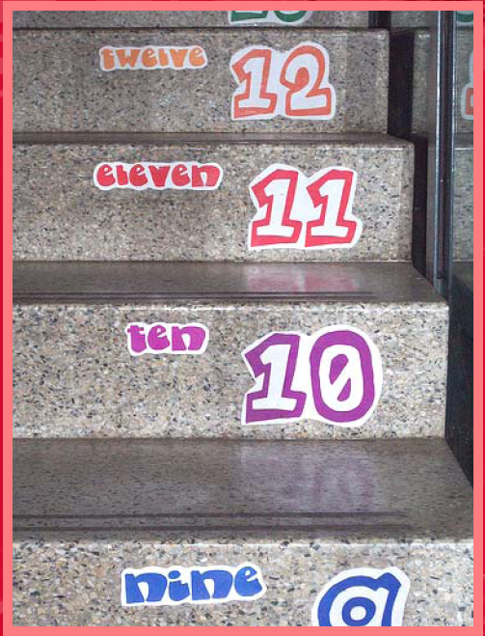
The Stairs

Slide 8
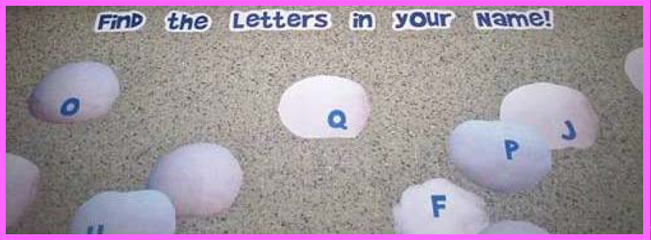
The Floor

Slide 9
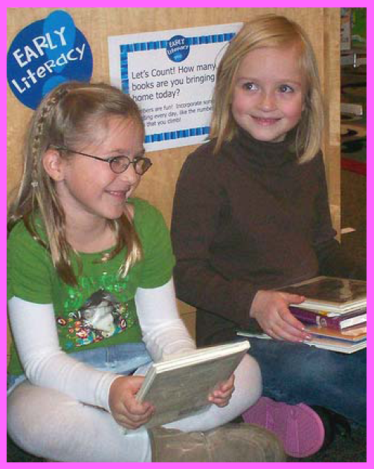
Stack Ends
Notes:
“Let’s Count! How Many Books Are You Bringing Home Today”

Slide 10
Stack Ends and More
Notes:
Mercy Watson series by Kate DeCamillo

Slide 11
Stack Ends and More

Slide 12
Circulation Desk

Slide 13
Puppet Theater
Notes:
We already had a puppet theater – we just added a sign

Slide 14
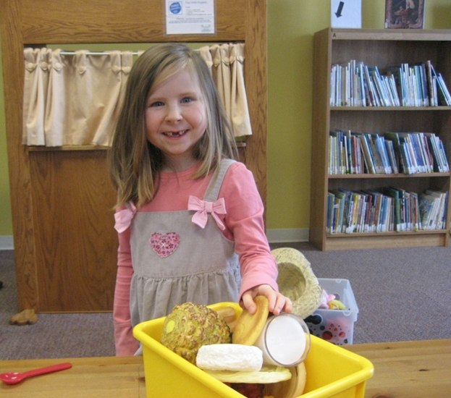
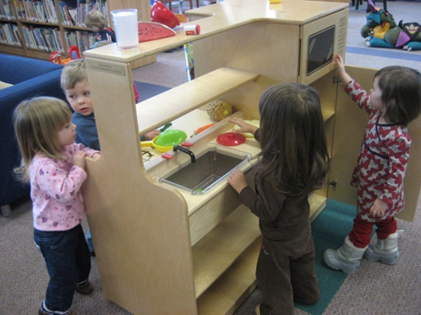
Play Kitchen / Food Basket

Slide 15
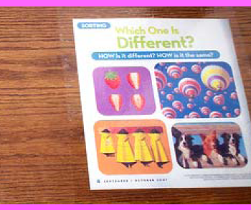
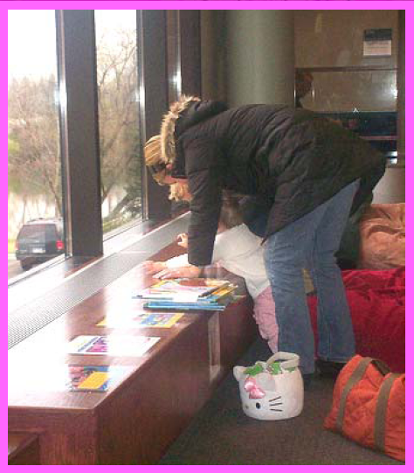
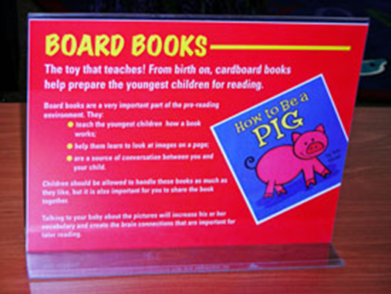
Table Tops

Slide 16
Table Tops
Notes:
With a $4 placemat cold laminated to a table top
Could do the same with this $3 placemap – How many states begin with the letter “M”?
Use what’s available – be creative.

Slide 17
Table Tops
Notes:
Show samples

Slide 18
The Bathroom

Slide 19
Fun With Magnets

Slide 20
Fun With Magnets

Slide 21
Fun With Magnets

Slide 22
Where To Go For More
http://www.tsl.state.tx.us/ld/workshops/earlylitkits/caterpillar-low.pdf
http://www.tsl.state.tx.us/ld/workshops/earlylitkits/links.html
http://www.earlylit.net/libraryenvironment/index.shtml
Notes:
Free Downloads through the Texas State Library
Good Bibliography on “Early Literacy in the Library Environment” which includes links to both the PLA workshop PowerPoint from Hennepin County Library and to their extranet for downloads.

