Slide 1
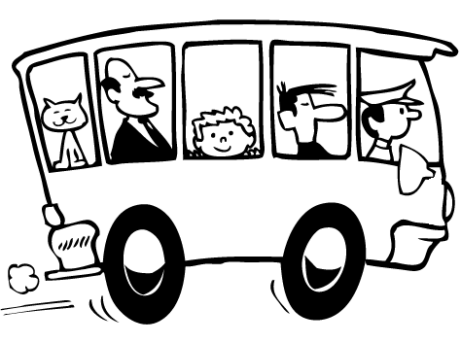
The Advocacy Day Bus Pitch

Slide 2
“Perseverance is the hard work you do after you get tired of doing the hard work you already did.”
Newt Gingrich

Slide 3
“Advocacy is a marathon,
not a sprint.”

Slide 4
Governor's Proposed Budget:
10% cut to Library Aid, reducing funding to below 1994 levels
Would represent a loss of approx. $100,000 to PLS over funding allocated for 2010/11

Slide 5
2011 NYLA Legislative and Budgetary Priorities
Top Priority:
Library Aid Should Not Be Targeted for Disproportionate Cuts
Proposed Library Aid cut – 10%
Proposed School Aid cut – 7.3 %
Proposed Municipal Aid (AIM) cut – 2%

Slide 6
2011 NYLA Legislative and Budgetary Priorities
Other Important Priorities:
Make Permanent Supplemental System Aid Funding (new bill)
Modify Public Library Construction Grant Program to allow purchase of vacant land & lower local match in high need areas (Farley/A.113 Paulin)

Slide 7
